Slide 1


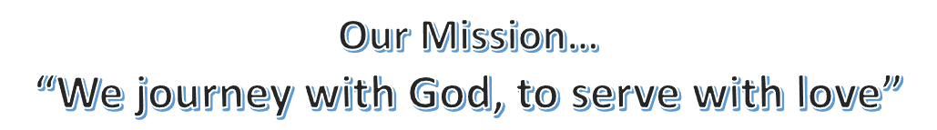
January 2024
Pastor Paul Busekist
Traverse City, MI 49686
(231) 947-9880
Website: www.bethlehemtc.org
Email: bethlehem@bethlehemtc.org
Building Hours:
Monday – Thursday, 9am to 2:30pm
Office Hours:
Monday – Thursday, 9am to 2:30pm
Worship Times:
Sunday: 10 am Modern Worship including Communion with service Livestreamed on Facebook and YouTube
Sunday School/Adult Education: 9:15am
Third Thursday Worship: 7:00pm
Nursery open during worship service
Follow the STAR to Bethlehem!
Our Vision…
“As a community of believers journeying with God together, we at Bethlehem are called to serve with love by growing a premier youth ministry; enlivening Christian discipleship through lifelong learning, care, and spiritual formation; fostering a vibrant and inspiring worship experience; utilizing our natural setting and location for faithful creation care and outdoor ministry; and opening our doors always to be a “campus at the crossroads” for the mission and ministry of Jesus Christ.”

Slide 2
“The story of Christmas tells us a lot about how God rolls…In our age of on-demand instructions, it is hard to accept the vague sense of direction we get in our spiritual lives. God does not give us the play-by-play of what is to come when He tells us to go. He just reminds us to pack lightly and take a lot of love!” – Bob Goff, Live in Grace: Walk in Love: A 365 Day Journey
Dear brothers and sisters in Christ,
This Christmas and New Years season, I am personally enlivened by many things. For one, I believe we took up the call of the Holy Spirit to provide real assistance to those in need in a special way – making our annual “Blue Christmas” service both a solace for the “blue” and an opportunity to help the hungry in our community. I will elaborate a bit more on this at our congregational meeting…
Another answer to prayer has been an opportunity that came to us by way of the synod: a call to examine how we witness to the community and world through the use of our building! The church council is now working with a non-profit called Solar Faithful to see how we might BOTH fulfill our financial stewardship AND actualize Bethlehem’s 5th and final 2012-2022 vision focus area – Creation Care and Outdoor Ministry. We could do that by exploring how our church roof can help the planet and save the church lots of money on utilities. How much, you ask? Well, our research with Solar faithful and conversations with other churches thus far show that (even after subtracting investment costs) over a 25+ year span, a 23Kw solar array on our Fellowship Hall roof could save us over $100,000 on electricity bills! For some, the point would be helping reduce fossil fuel usage, but for others it is better stewarding the church’s assets. It appears both objectives can be reached, and I invite you to hear updates at the January 7th Congregational Meeting and beyond.
Finally, I leave you with a second quote from Bob Goff’s book below. May we faithfully stride into the future, with the Christ child inspiring us to care for one another always:
In peace, Pr. Paul
“…Who we are after Christmas morning says a lot about who we found in the manger. If you find a God who gave up everything to come live with us and die for us so we could finally get a taste of grace, you will want to give that grace to everyone you encounter. It is as if, from a manger in Bethlehem, God leaned over the whole world and said, ‘It is your move.’ Do not be discouraged just because you do not have all the answers. God is not sending you on a business trip. He is inviting you to join Him on an adventure which will always lead you to Jesus. How will you respond to His calling as we approach this New Year?” – Bob Goff, Live in Grace: Walk in Love: A 365 Day Journey
PROSE FROM THE PREZ:
Oops…your rookie council president is definitely learning as she goes along. I believed that the necessary communication was completed so that an extra payment of $30,000 was already made on the mortgage as I stated in the Nov. STAR. This did not occur. Then, as both the finance committee and council considered ways for our current extra money to MAKE more money we realized that paying a sum of money on the mortgage in advance is NOT in our best interest. Right now we have a very favorable interest rate on our Money Market account. Because of the large amount of money there from the sale of the house, we are making more money than we are spending on loan interest. With the less than desired projected income from our current pledge drive there is no way that we can pay everyday expenses plus our full mortgage payments. So, as our proposed 2024 budget shows we will gradually during the year make a transfer of $42,000 from the Money Market account towards the monthly loan payment. This will mean that our mortgage will be paid off by Nov of 2025 and before then we will be well sheltered by a new roof and well heated by a boiler upgrade, and perhaps more.
Please pick-up your budget in the back of church if you have not done so already and plan to attend our congregational meeting on Sunday Jan 7 after the service.
Blessings of joy and health in this New Year! Cindy Monroe BLC Council President

Slide 3


You are all wonderful! The Fellowship Committee would like to thank all of the volunteers for the Advent meals. You are all so wonderful. We had nice evenings of food and fellowship. And a special thank you to Phil Bossardet for his planning and cooking the meal on December 21st for Blue Christmas Service. Sign-up sheets for Lent are already on the table in the Gathering space or contact Gail Goldsmith by text or phone at 231-633-2630 or at ggoldsmith74@gmail.com
New member orientation: We hope to schedule a gathering in January or February for anyone considering membership. Please contact Pastor Paul, membership chair, Cindy Monroe at cmonroe@chartermi.net or the office at 947-9880 if you are interested in joining Bethlehem.
Spotlight on Zeke: So many of us enjoy Zeke’s talents with religious music, but did you know that he plays other kinds of music at various locations in the Traverse City area? Here is a list of his engagements in the next month that are close to TC:
Wed 01/03—Park Place/Minerva’s Happy Hour 4PM
Wed 01/10—Park Place/Minerva’s Happy Hour 4PM
Wed 01/17—Park Place/Minerva’s Happy Hour 4PM
Wed 01/24—Park Place/Minerva’s Happy Hour 4PM
Wed 01/31—Park Place/Minerva’s Happy Hour 4PM
Choir News: Happy New Year! I hope that you had a wonderful Christmas, and that you enjoyed Shepherd's Joy, and Christmas Communion Song during the Christmas Eve liturgy. The choir worked hard to prepare them and we always hope that the words and melodies we sing draw you closer to God. On January 28, the choir will sing, O Jesus, Joy of Loving Hearts, a traditional Scottish melody arranged by Robert Powell. We will rehearse on Thursday, January 11 and January 25 at 7:00 pm. If you'd like to join us, email me at bero.tony@gmail.com, or text/call 231-942-1162. Or simply show up at a rehearsal! Peace be with you always.
It’s Time For Safe Harbor!
Bethlehem will be hosting at Safe Harbor on January 27, 28, and 30. Cindy Monroe and her kitchen team will be offering a chicken & rice dish on Saturday the 27th; Tina Dohm and her group an Italian lasagna on Sunday the 28th, and B.J. Christensen and friends a ham and scalloped potatoes dinner on Tuesday the 30th. As a reminder, “Loaves & Fishes” handles each and every Monday night throughout the winter season.
Sign-up sheets for other jobs at Safe Harbor and for donating snacks will be posted in the Gathering Space at Bethlehem on January 7th. It will be important to fill those quickly. If you have any questions on job responsibilities you are considering, please call me. Full-time Safe Harbor personnel will always be with you. Food donations will be due as follows- at BLC on 25 JAN for27JAN; at BLC by 28JAN for 28JAN; at BLC 30JAN for 30JAN.
Tom Rockne, Bethlehem Safe Harbor Coordinator, Mobile 231.631.0040

Slide 4

A big thank you to all who turned in Olesons’ receipts. We just received a check from Olesons for $268.15 for a total of $593.03 this calendar year. Please continue to drop off your Olesons’ receipts at Bethlehem. Please note they do not expire. Thank you.
Contra Dancing by Bayside Travellers Contra dancing is similar to square dancing, and each of their dances feature live music by local folk bands. They will be back with us for dancing on January 13th. All are welcome to attend, no partner or experience is necessary! The dances are by donation. For more information or further dates, please reach out to Alanna at alanna.steffunick@bethlehemtc.org
Food Pantry: We will NOT be closing our outdoor pantry for winter this year. We have a new member who ran an outdoor pantry downstate and she has given us lots of ideas of foods that can be stored there during the cold months including: hamburger helper, stuffing mix, dry milk, instant potatoes, cookies, and rice. Also, there is always room for dry goods such as toilet paper, paper towels etc. Please start looking for some of these items when they are on sale and bring your extras to the coat room. Your generosity is so appreciated.
Wednesday Bible Studies:
Adult Bible Study: meets in the Youth Room from 9:30-11:30am, with the Gospel of John. Continues as of January 10th.
The Zoom Book and Bible Study: meets on Wednesdays from 1:30-3:00pm. The next study will begin January 10th with a study of the book of Mark.. If you are interested in joining this group, please contact Barbara Oster or Pr Paul.
Adult Education in the Youth Room plus Sunday School - every Sunday at 9:15am
The next Third Thursday service will be a Taize 1 service on January 18th at 7:00pm. The service will be livestreamed. The BLC Fellowship Committee will be providing a meal at 5:45 p.m. Please come early and share in fellowship and stay for the service.
January’s XYZ Potluck & Presentation will be on Friday, January 12th at 12pm noon. While primarily geared toward seniors, the group is open to any adult who would like to attend! XYZ meets monthly September through May for a potluck lunch, followed by a program or presentation. January's presenter is Ali LeJeune of Simply Ali. Ali is a locally based professional that focuses on helping you find peace and calm in both your life and your home.
FOR BOOK CLUB MEMBERS AND ANY WHO LOVE TO READ:
The book club will discuss Lessons in Chemistry by Garmus at its Jan 23 pizza dinner meeting at 5:30. Don’t be deceived by the title of this book. It actually should make you laugh outloud!!! Yes, some chemistry is involved, but so much more! There are still some copies of the book in the bin outside the front door. Just sign your name on the sheet by the corresponding number of your book. Please contact Cindy Monroe at cmonroe@chartermi.net if you want to participate and cannot come to church in order to give plenty of advance notice so that ZOOM can be set up.

Slide 5
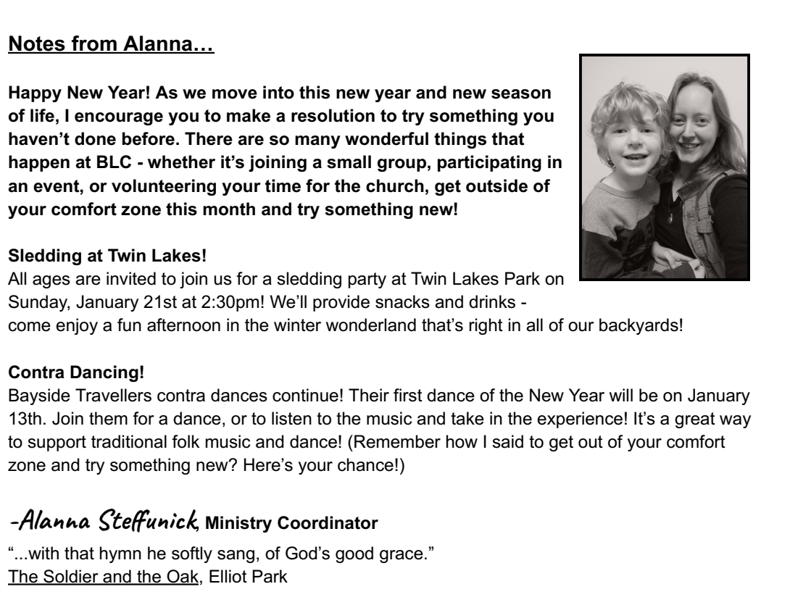


Slide 6

FINANCIAL NEWS
November income was $34,440, compared to projected income of $30,944. We received $3,496 more than projected. Expenses were $44,056, compared to a budget of $31,113. This resulted in spending $12,942 more than budgeted. For the month, the church brought in $9,615 less than we spent.
Year-to-date income is $346,569, compared to projected income of $332,619. This resulted in the church receiving $13,950 more than projected. Expenses were $364,745, compared to a budget of $357,591. We have spent $6795 more than budgeted. For the year, the church has spent $18,176 more than we brought in.
Coffee and Cookies on Sunday: Remember that treats and a hot drink on Sunday are appreciated by all. Please take a moment to sign up to bring cookies or some other tasty treat on the Sunday that works best for you. Or sign up to prepare the coffee. As requested by some of our new members there is a plan in the works to have one Sunday per month when we join in the Fellowship Hall. We can sit at a table and chat with someone new while we munch on a treat. More on that to come…
Dear Members of Bethlehem Lutheran Church,
It's that time of year; the leaves start to turn color and fall to the ground. It is also the time of year when we like to take some time and gratefully thank the congregation for your continued support of our wonderful church. We are all grateful to have such abundant blessings with our location and our faithful members. It's important to remain dedicated to our Christian faith and do our best to follow through on our commitments. With love & kindness we ask that if you are able and willing to help the church in a financial way, we really need your help. Contributions are behind where we should be for the start of the fourth quarter. This is primarily because of pledged money that has not yet been received. We respectfully ask that if you can do what you have pledged or even a little bit more, the church will put those dollars to good work. Thank you for prayerfully considering this appeal. We appreciate your support and are grateful for all you do to make Bethlehem Lutheran Church a thriving community of believers. Jim Monroe, BLC Financial Secretary and Phil Anderson, BLC Bookkeeper
Our Care Giving Committee has put up a “Communitas” Board on the wall of our Coat Room! This “BOARD” is needed and helpful for ALL of us! Following is a suggestion of some things YOU and our YOUTH can do to “interact” with the board and other members of our congregation. The purpose of our “Auxilium Communitas” BOARD (Latin for “Community/Congregation Assistance”) is to SHARE our gifts, talents, or skills to others that might be in NEED of something like: Gardening, Organizing, Painting, Raking leaves, Shoveling, Household tasks, Carpentry, Manicures, Pedicures, Companionship, Care giving, etc. - This list is Endless! You never know when YOU will be in need of some extra help personally, in your home or yard – let's make this “reciprocal” - All ages are Welcome to Help Service our Congregation!

Slide 7
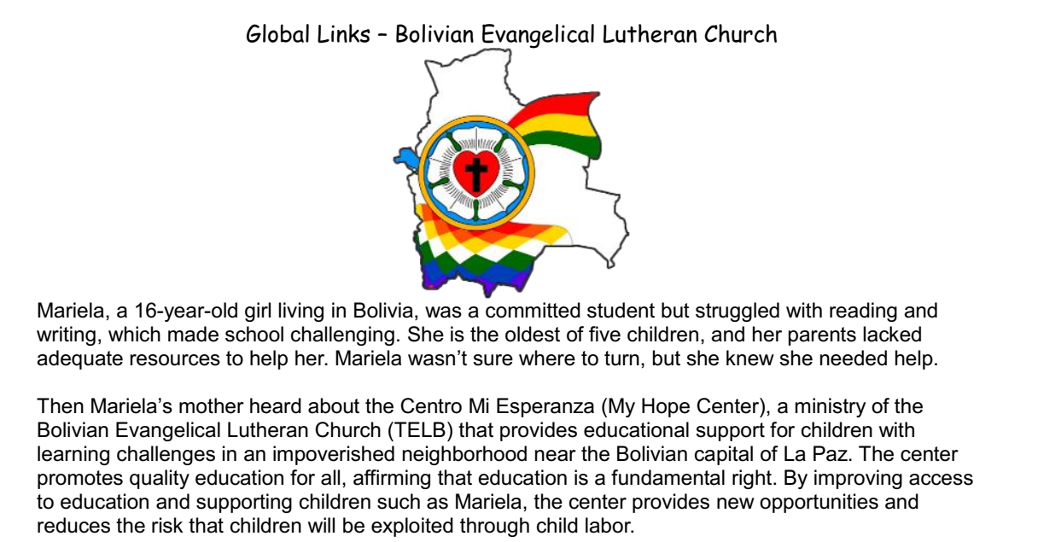
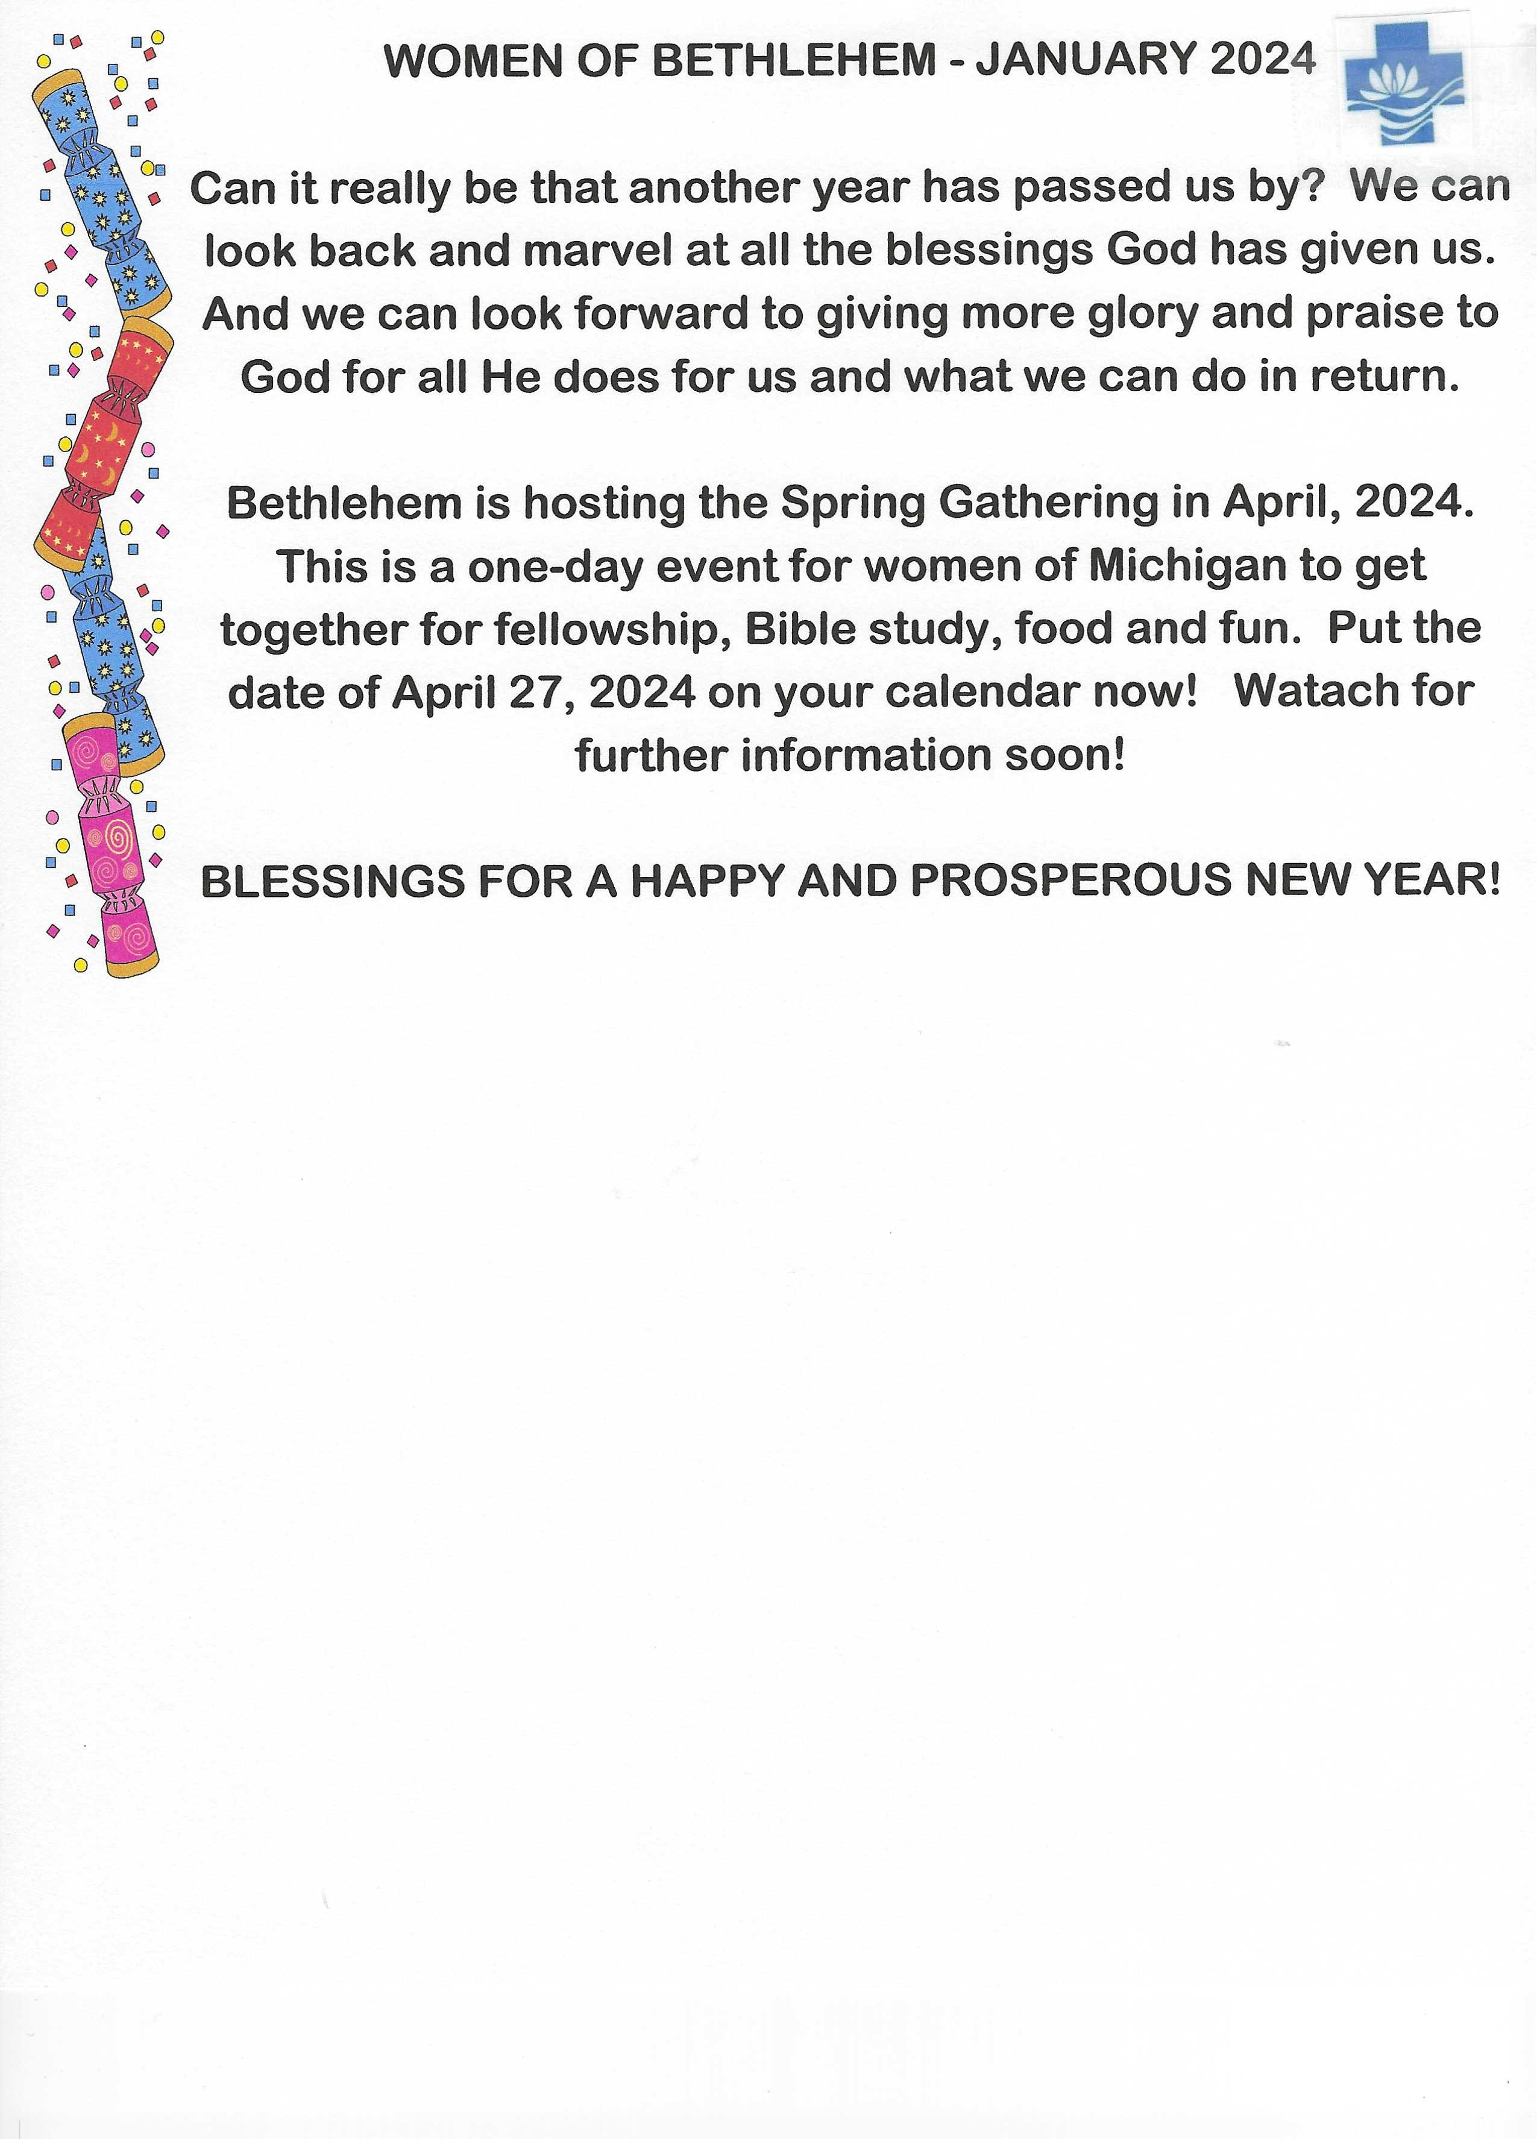

Slide 8

Health Concerns*
The Power of Prayer
Richard Fernholz, Nancy Smith, Tom & Lee Miller,
Margie Whitney, Judy Fenton, Julie Lapeer, Milt & Carol Bowes,
Lynn Hoyt, Tom Woodworth, Ron Hellenga,
John Stretlien, Harper Wiemerslage,
Russ Luttinen, Sherry, Leroy Schlagel,
Roy & Marilyn Dumond, Sean Rivard,
Brenda Denoyer and the Denoyer Family,
Patti McCracken, Sharon Vanmeter,
Margaret Hutchison, Carol Collins,
Patience Lambert, Dale Leider, David Suby,
Jennifer Mowers, Debbie Knopf,
Gail Goldsmith, Kathi Ivany,
Jim Rumbach, John Block, Dan Deutsch,
Earl Manuel, Jack McCracken
French Manor South: Brenda Denoyer Orchard Creek: Margie Whitney
Evergreen Cottage: Milt & Carol Bowes
Boardman Lake Glens: Inge Thomas
Hospital Visits: Please let the church office know if you are going into the hospital for a scheduled procedure or an emergency so Pastor Paul can visit you.
Prayer Requests:
•Prayer Chain: Please contact Jan Stretlien at jstretlien@gmail.com or 231-947-3265
•Prayers read from the altar: Please call the Administrative Assistant in the church office 231-947-9880
Are you checking for the latest BLC updates at: www.bethlehemtc.org?
You saw Norm and others take the photos...be sure you see them at www.bethlehemtc.org!
Good News...and great news...at www.bethlehemtc.org...
Looking for a link to last month’s full Council minutes?
Type this address/url into your web browser to get the latest approved minutes from Council (or call the office for a copy:
bethlehemtc.org/Council-Minutes

Slide 9
BLC Contacts
Church Office
Pastor Paul Busekist paul.busekist@bethlehemtc.org
Admin. Asst., Barbara Oster admin@bethlehemtc.org
Bookkeeper, Phil Anderson bookkeeper@bethlehemtc.org
Tony Bero, Music Director bero.tony@gmail.com
Alanna Steffunick, Ministry Coordinator Alanna.Steffunick@bethlehemtc.org
Website www.bethlehemtc.org
Church Council
Cindy Monroe, President president.council@bethlehemtc.org
Paul Wiemerslage, Vice President vicepresident.council@bethlehemtc.org
Jana Rockne, Secretary secretary.council@bethlehemtc.org
Gary Ancinec, Treasurer treasurer.council@bethlehemtc.org
Jim Monroe, Financial Sec. financialsecretary.council@bethlehemtc.org
Jim Hinds, Christian Care Giving christiancaregiving.committee@bethlehemtc.org
Tina Dohm, Christian Ed. christianeducation.committee@bethlehemtc.org
Gail Goldsmith, Fellowship fellowship.committee@bethlehemtc.org
, Membership/Evangelism membershipevangelism.committee@bethlehemtc.org
, Property property.committee@bethlehemtc.org
Maureen Bauer, Personnel personnel.committee@bethlehemtc.org
Scott Farley, Stewardship stewardship.committee@bethlehemtc.org
Denice Bossardet, Worship and Music worshipmusic.committee@bethlehemtc.org
Tina Dohm, Youth/Y2A youth.committee@bethlehemtc.org
Pastor Paul Busekist paul.busekist@bethlehemtc.org
If you have an interest in serving on any of the above Committees,
Please contact the Committee Chairperson(s).

Slide 10
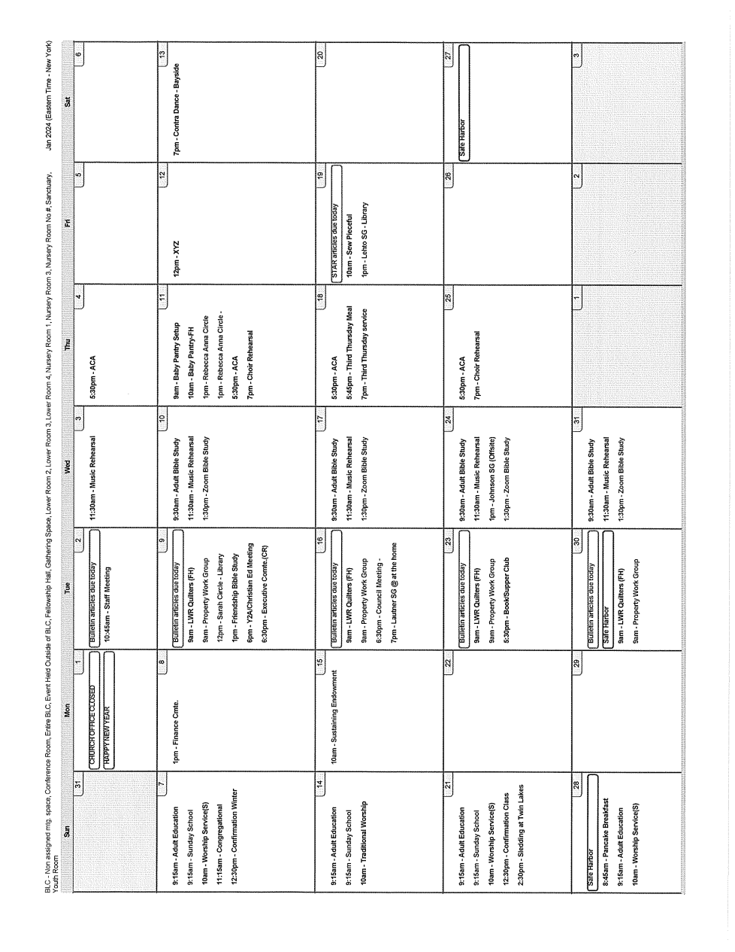

Slide 11
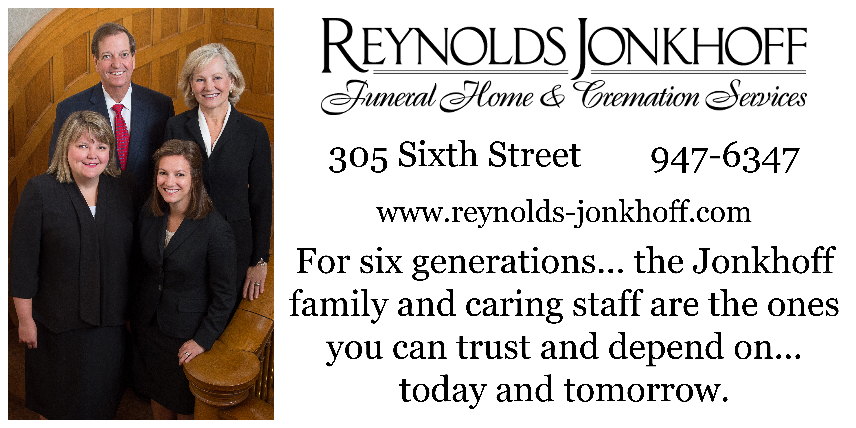
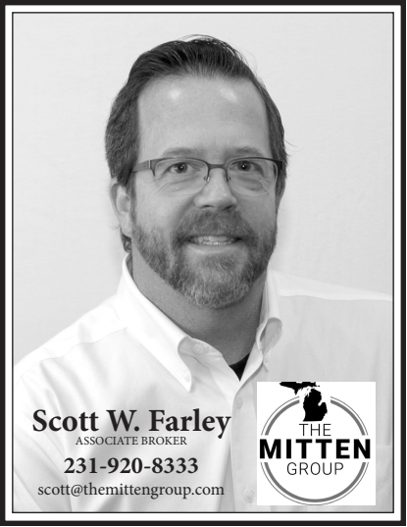
Monthly donation: 1/16 page $25; 1/8 $50; 1/4 $80. Pay for a year in full---get 1 Month Free
Questions??? Please contact Scott Farley 231-920-8333 or swfarley@charter.net Make checks payable to BLC…put “Star Ad” on envelope.

Slide 12

IMPORTANT NOTICES
Save the Date: Congregational Assembly –
after service on January 7, 2024.
2. if you are receiving this in the mail and prefer NOT to, please contact the office. 231-947-9880 or admin@bethlehemtc.org
Bethlehem Lutheran Church (ELCA)
1050 Peninsula Drive
Traverse City, MI 49686
www.bethlehemtc.org
231.947.9880

