Slide 1


August 2025
Pastor Paul Busekist
Traverse City, MI 49686
(231) 947-9880
Website: www.bethlehemtc.org
Email: bethlehem@bethlehemtc.org
Building Hours:
Monday – Thursday, 9am to 2:30pm
Office Hours:
Monday – Thursday, 9am to 2:30pm
Worship Times:
Sunday: 10 am Modern Worship including Communion with service Livestreamed on Facebook and YouTube
Sunday School/Adult Education/Third Thursday: will return in September
Nursery open during worship service
Follow the STAR to Bethlehem!
Our Mission:
We worship, work and welcome…Sharing God’s love and grace with all.
Our Vision:
Together, we embody our mission by BOLDLY following Jesus, serving the needs of the world and one another, and caring for all of God’s Creation. ALL ARE WELCOME.

Slide 2
³⁵ For I was hungry and you gave me something to eat, I was thirsty and you gave me something to drink, I was a stranger and you invited me in, ³⁶ I needed clothes and you clothed me, I was sick and you looked after me, I was in prison and you came to visit me.’ - Matthew 25:35-36 (NIV)
^{God’s Work, Our Hands – Part 1}
Friends at Bethlehem, I have been thinking a lot about what I call “Matthew 25 moments.”
As Christ calls his followers in the famous passage in Matthew chapter 25, we too are called both individually and collectively to embody both mission and outreach. Ever since our momentous last year of visioning – with our team, Roger Hardy and the whole congregation – I have watched our BLC brothers and sisters step up in so many ways: for Safe Harbor, the Baby Pantry and Food Pantry/Kiosk, and the Cherry Festival…not to mention another wonderful year of Vacation Bible School that just completed (thanks, Alanna and other volunteers and fellow leaders!)
Now, I ask myself two new questions. First, how will Bethlehem “make a new mark” on the Traverse City community? Second, are there ways we can increase our outreach without adding too much administrative burden on our people? For that first question, we really need to let the process of continued visioning play out on “God’s Work, Our Hands” Sunday, September 7, when we branch out into 3 groups – with each of us picking a vision focus area (Social Ministry and Outreach, New Life Together, and Creation Care.) This will be an exciting moment to begin some new ministries as BLC.
But that second question is equally exciting, at least for me. As a person, I want to make new decisions to see how I can not only be a part of something new, but lend time here and there to “Matthew 25 moments” that are already coming our way. Two examples of such invitations were the “Taste of Honduras” event we attended at Peace Lutheran in Gaylord on July 26th, and the upcoming visit from the Holy Land Christian Solidarity Cooperative on August 10th. These are “ready-made” opportunities we have gladly accepted. Might there be others? For the upcoming month as we gear up for another fall of visioning, there may be ways to support Stony Lake Lutheran Camp, for example (i.e. individually volunteering for support in their Ragnar Run effort) or partnering with our friends in TC or Northport for the CROP Hunger Awareness Walk, etc…Then, may we hear the call of Christ affirm what we know to be at the root of all this mission – the love of Christ, from Matthew 25:
Shalom, and be well.
- Pastor Paul
³⁷ “Then the righteous will answer him, ‘Lord, when did we see you hungry and feed you, or thirsty and give you something to drink? ³⁸ When did we see you a stranger and invite you in, or needing clothes and clothe you? ³⁹ When did we see you sick or in prison and go to visit you?’ ⁴⁰ “The King will reply, ‘Truly I tell you, whatever you did for one of the least of these brothers and sisters of mine, you did for me.’
A Word From the President:
I feel very blessed to serve as BLC Council president We have a wonderful group of people on the council this year. I look forward to working with each of you.
This month has been busy with the basement issues. We have such a great group of Property Guys who keep our church clean and in good maintenance on a regular basis. They have worked so hard to keep the water out of the lower level. A Big Thank You goes to Doug Cunningham for not only organizing work crews and working with outside companies to find relief to our problems. He is at the church so much, I have teased him that he needs a cot to sleep there. So when you see Doug, give him a nice pat on the back.
Have a wonderful month and blessings to you all.
Gail Goldsmith

Slide 3
MAY 2025 FINANCIAL NEWS
June income was $33,459 compared to budgeted income of $29,793. We received $3,666 more than budgeted. Expenses were $33,813 compared to a budget of $34,143. We spent $330 less than budgeted. From a cash flow perspective we spent $354 less than we took in. June was a breakeven month…very refreshing. Basement Project income and expense is being tracked separately and not included in monthly or YTD totals.
GREAT NEWS!!! The Solar Tax Credit (i.e., rebate) of $53,869 came in on June 30th. It is Non-Operating Income and therefore not included in the above numbers. Council is reviewing options on how best to utilize these funds.
Year to date income was $186,450 compared to budgeted income of $182,035. We have received $4,415 more than budgeted. Expenses were $216,134 compared to a budget of $202,185. We spent $13,949 more than budgeted. For the year, the church has spent $29,684 more than we have brought in primarily due to unanticipated property repair expenses.
Beach Day! Let's have an intergenerational beach trip to round out summer! All ages welcome! Join us at Bryant Park (across from BLC) on Friday, August 15th from 11am - 1pm for a few hours of swimming and fun. Chips and drinks will be provided - bring a sack lunch if desired! Additional parking at BLC if needed. For questions, contact Alanna Steffunick-Boomer!
Pr. Ruth: Our beloved friend in Christ, Pr Ruth Overdier, has some devotions in the September portion of Christ in Our Home. You can read her selections from September 16 – 30.
What IS GRIEVING? Could it be the loss of a marriage, your home, or community, good health, a dream or something else? The list can go on and on. No matter the loss you have a family here at Bethlehem that loves you, wants to support you, and be here for you! We meet here on the first Monday of the month from 3:30-4:30 and on the third Monday from 5:30-6:30. If you have any questions, please contact Peggy Burns 231-392-6913.
Chair Yoga: Chair yoga is back at 3:00 on Mondays and Wednesdays to Bethlehem. Cost is still $5. Invite your friends. It is a great stretching exercise and we work on balance issues.
Bethlehem August Safe Harbor Update Bethlehem support for Safe Harbor’s Summer has been Red Hot! The third Tuesday of each month MAY-SEP we provide staff to assist with check-in, meds, guest assistance, and more. August 19 and September 16 yet to come. Oue BLC Hot Dog Picnic on June 25 was a first time ever event for Safe Harbor and a huge success. We are going to host another on August 27! Check the display in the Gathering Space and see how much fun serving can be! Thank you to a wonderful, overflowing group of volunteers! Tom Rockne, Bethlehem Safe Harbor Coordinator tomrockne@gmail.com or M.231.631.0040.
PROTECT OUR CARPET: spills always happen, but we now have TWO consistent ways to deal with them. Thanks to an anonymous donor we now have an actual carpet cleaning machine stored in the maintenance closet. If you cause one or see a spot, please grab the spot cleaner in the squirt container below the sink in the fellowship hall. Just follow the directions on the bottle and we should be able to keep our carpet in good condition. But, it the stain is too big or too resistant, please use the carpet cleaning machine. Thank you!!
HOW DO WE CARE AND SERVE? John 12:26 “Whoever serves me must follow me; and where I am, my servant will also will be. My Father will honor the one who serves me”.
YOU ARE LOVED BY YOUR CHURCH FAMLY. If you would like to have a visit and you would like to receive Communion, Christian Care Giving is here for you! Please let Peggy Burns at 231-392-6914 know and we will have one of our Care Givers come and see you.

Slide 4
We had another successful Parking Lot Fundraiser this year! While there were some elements that were out of our control (rain, e-coli at the beaches, etc.) we still had a wonderful fundraiser and brought in $2,624 to benefit our youth program! Many thanks to these wonderful volunteers who made it all possible: Kathie Bair, Steve Kramer, Forrest Bowling, Nariah and Noah Finch, Owen Munger, Braxton Rhodes, Sammy Steffunick, Renae Wells, Pastor Paul & Parker Busekist, Dave Peppler, John Halstead, Jana and Tom Rockne, and Tracey Moyer!
Garden News: Thanks to all who have been involved in the garden in any way. If you have not been across the street to check on what’s happening, the biggest news is, THE RADISHES AND SQUASH ARE BEING HARVESTED!!!!. Carrots and tomatoes are on the way! Feel free to go there at any time. Do a little weeding. If any part of the garden looks stressed due to the heat, feel free to sprinkle using the hose on the north fence (irrigation only runs on alternating days). If something needs to be picked please do so. If no collection boxes are out, please take the produce into the Faith building. Enjoy meeting some new people from other churches when you are there. If questions contact Cindy at cmonroe@chartermi.net
FOOD PANTRY: With summer in full swing, it is important to remember that there are still hungry community members amongst us. When I checked the pantry on arriving to church last Sunday I found it was almost completely empty. The storage room where we keep the food to restock was also almost completely empty. I urge each and every one of you to bring just one non-perishable item to donate to the food pantry the next time you come to church. If every member brings one item to donate, we can quickly restock our supplies. The need never ends and we are counting on you to step up to the plate to support community members in need. Thanks for your support, Suzanne and Kathie
A big thank you to all who have turned in Olesons’ slips. On March 31st, we received a check from Olesons for $275.60 from receipts turned in. This makes a grand total of $592.66 for the year 2025. Olesons’ slips never expire. Please continue to turn in your Olesons receipts to Bethlehem. Thanks so much!!! Also, the area for the Oleson receipts is in the lower cabinets below the mailboxes (under the A-B-Cs…). The cabinet door is marked with the receptacle inside. Unfortunately, we are no longer collecting the receipts from Family Fair.
FREE ENTERTAINMENT: When you just want to do something or take your out-of-town visitors somewhere…
• Mon Aug 4 at 6:00 (notice the earlier time) at the Civic Center : String-a-palooza! Bring your chair or blanket
• “Saturdays in the Park”: 7-9 in the Civic Center all summer ( donation bucket available but optional)
• Sat Aug 30 11:00am at the TC Phil 1724 S Garfield Ave Saturday Family Concert (shorter than 1 hr.)

Slide 5
BLC partners with Old Town Playhouse for the musical telling the story of Moses in THE PRINCE OF EGYPT: Still looking for some volunteers to run concessions at Milliken Auditorium on Aug 22 for the 7:00 show and Aug 23 for the 2:00 show. (The youth are running concessions on Thursday. Aug 21 and their youth fund will receive the benefits.) For the other days funds earned can be designated to the charity or cause recommended by the volunteers. Bethlehem’s Good Samaritan Fund? Project Feed the Kids? Safe Harbor? Grand Traverse Baby Pantry? Another idea? It’s easy to sell items before the show and during intermission. Sign up in the gathering space or contact Cindy Monroe at cmonroe@chartermi.net or 231 631 0887 if you can help. You can also sign-up to reserve tickets to see the show. If tickets are purchased in groups of 6 each will cost $42 for an adult and $18 for youth under the age of 18. IF WE DON’T HAVE THAT MANY PEOPLE FOR THE PREFERRED DAY, TICKETS WILL COST MORE.
SAVE YOUR PAPER SACKS: Please check the nooks and crannies of your home for paper sacks. The Baby Pantry fills requests from preschool teachers for their students whose parents cannot make it to the pantry. Paper sacks are the perfect size to place the needed items for each child. Just place your bags on the Care table in the coat room. Thank you!!
BOOK CLUB NEWS: There will be no gathering in August. Watch the bulletin and Sept STAR for info on the time, location, and book for the September meeting. If you are not currently on the email list to receive information please contact Cindy Monroe at cmonroe@chartermi.net.
SUMMER BIBLE STUDY: This is the final update! Our summer Bible study will be held on Thursday, August 28th at noon in the Fellowship Hall. Please bring a dish to pass; meat and beverages will be provided. Our study will be taken from Sessions 2 and 3 in the June/July/August Gather magazine: "Where two or more are gathered: Flourishing in relationships" when we will discuss relationships that sustain us and relationships that help us grow. There will be a signup sheet in the gathering space from August 3rd through August 24th. Please indicate if you need a copy of the lessons and one will be provided for you. Join us for an afternoon of good food, great fellowship and a lot of fun!
We are wanting to update the list of people we pray for. If everyone could let us know of any changes, whether it is people who can be taken off, or should be added, we would appreciate it. Please respond by email to admin@bethlehemtc.org
SUMMER BREAK: Please note that Sunday School, Sunday’s Adult Education along with the two Wednesday Bible Studies will not meet during the summer months. Look for the September start dates in the weekly email, bulletins and the STAR at the end of summer.
Norm Fred has helped a previously homeless couple for a few years. They are proud people and do not like to be given charity but they will accept help in the form of donated cans that they can recycle for money. Please bring in your recyclables in for them. Leave them in plastic bags by the garage. These are nice people. There, but for the Grace of our God, go we.

Slide 6
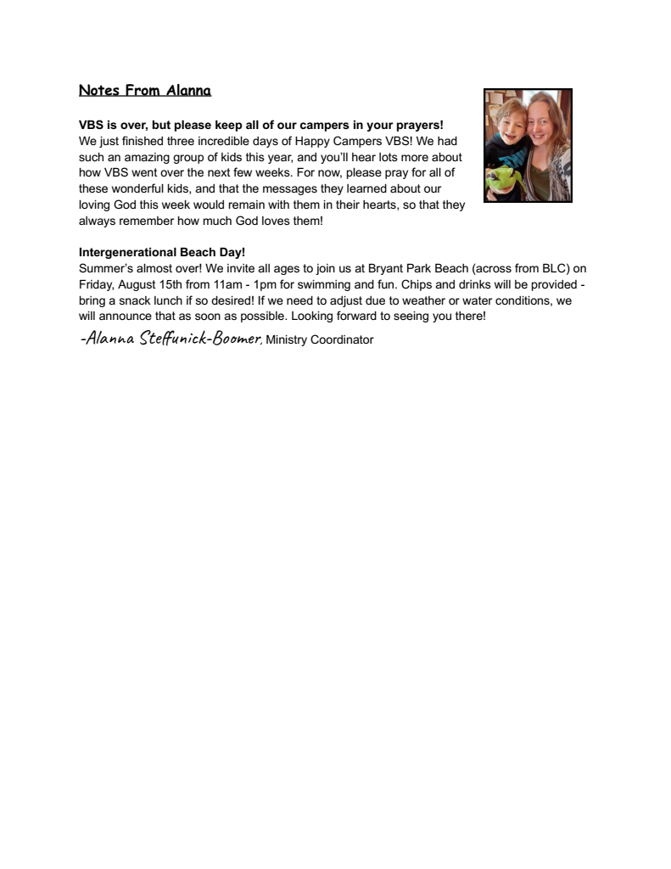


Slide 7
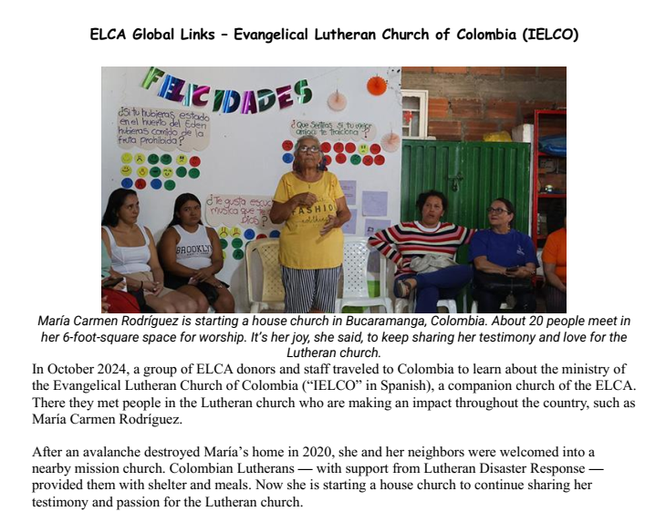
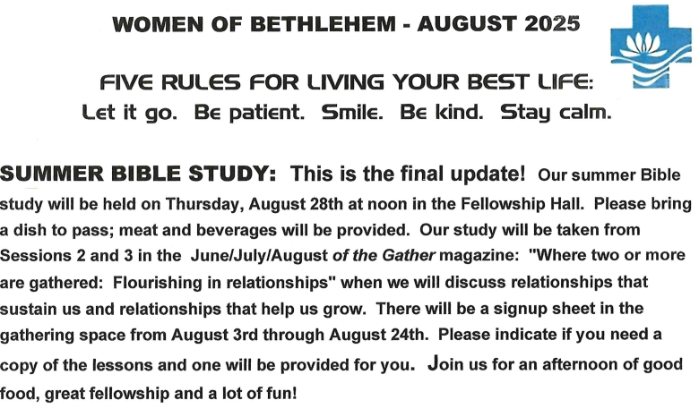

Slide 8

Health Concerns*
The Power of Prayer
Mary Woodring, Jerry Hill,
Richard Fernholz, Tom & Lee,
Judy Fenton, Julie Lapeer, Milt & Carol Bowes,
Lynn, Ron Hellenga, Cindy Hitesman,
John Stretlien, Harper Wiemerslage,
Leroy, Roy Dumond, Dale & Cheryl,
Patti, Sharon, Julie Barrett, Steve, Christine,
Sherry, Debbie Knopf, Suzanne Lehto,
Jim Rumbach, John Block, Bob,
Marianne, Norm Fred, Chris,
Kyle, Cameron, Ben, Janet, Cheryl
Meadow Valley: Milt & Carol Bowes
G. T. Pavilions: Shelley Miller
Hospital Visits: Please let the church office know if you are going into the hospital for a scheduled procedure or an emergency so Pastor Paul can visit you.
Prayer Requests:
•Prayer Chain: Please contact Jan Stretlien at jstretlien@gmail.com or 231-947-3265
•Prayers read from the altar: Please call the Administrative Assistant in the church office 231-947-9880 or email admin@bethlehemtc.org
Are you checking for the latest BLC updates at: www.bethlehemtc.org?
You saw Norm and others take the photos...be sure you see them at www.bethlehemtc.org!
Good News...and great news...at www.bethlehemtc.org...
Looking for a link to last month’s full Council minutes?
Type this address/url into your web browser to get the latest approved minutes from Council (or call the office for a copy:
bethlehemtc.org/Council-Minutes

Slide 9
BLC Contacts
Church Office
Pastor Paul Busekist paul.busekist@bethlehemtc.org
Admin. Asst., Barbara Oster admin@bethlehemtc.org
Bookkeeper, Phil Anderson bookkeeper@bethlehemtc.org
Anthony Bero, Music Director bero.tony@gmail.com
Alanna Steffunick-Boomer, Ministry Coordinator Alanna.Steffunick@bethlehemtc.org
Website www.bethlehemtc.org
Church Council
Gail Goldsmith, President president.council@bethlehemtc.org
Maureen Bauer, Vice President vicepresident.council@bethlehemtc.org
Nancy Pflasterer, Secretary secretary.council@bethlehemtc.org
Dave Peppler, Treasurer treasurer.council@bethlehemtc.org
Jim Monroe, Financial Sec. financialsecretary.council@bethlehemtc.org
Peggy Burns, Christian Care Giving christiancaregiving.committee@bethlehemtc.org
Tina Dohm, Christian Ed. christianeducation.committee@bethlehemtc.org
, Fellowship fellowship.committee@bethlehemtc.org
John Halstead, Membership/Evangelism membershipevangelism.committee@bethlehemtc.org
Doug Cunningham, Property property.committee@bethlehemtc.org
Maureen Bauer, Personnel personnel.committee@bethlehemtc.org
Jana Rockne, Safety & Security
Bethany Uhl, Stewardship stewardship.committee@bethlehemtc.org
Denice Bossardet, Worship and Music worshipmusic.committee@bethlehemtc.org
Tina Dohm, Youth/Y2A youth.committee@bethlehemtc.org
Pastor Paul Busekist paul.busekist@bethlehemtc.org
If you have an interest in serving on any of the above Committees,
Please contact the Committee Chairperson(s).

Slide 10
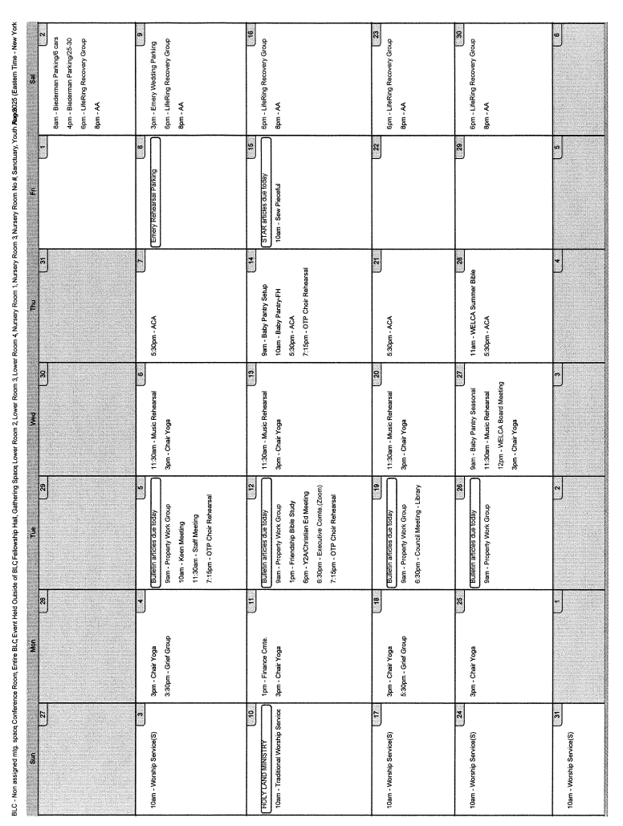

Slide 11
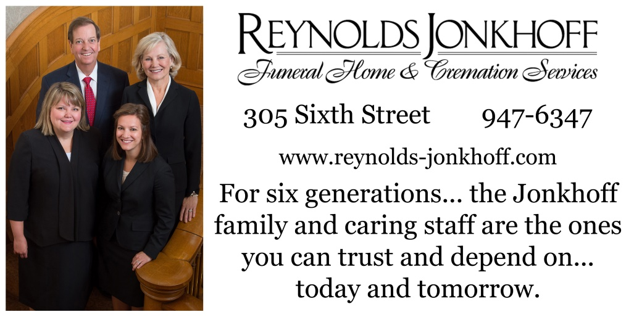
Monthly donation: 1/16 page $25; 1/8 $50; 1/4 $80. Pay for a year in full---get 1 Month Free
Questions??? Please contact Alanna Steffunick-Boomer at 231-947-9880 or alanna.steffunick@bethlehemtc.org Make checks payable to BLC…put “Star Ad” on envelope.

Slide 12

Lots of cool information inside
Pr Paul’s Page
Council President’s notes
Council officers and committee liaisons
Grief Group
Book Club News
Prince of Egypt at OTP
Chair Yoga
Safe Harbor Volunteer Opportunities
Beach Day
Free Entertainment in Traverse City
Notes from Alanna
Christian Education News
Financial News
ELCA Global Links
Women of Bethlehem 2025
The Power of Prayer
Church Calendar
Bethlehem Lutheran Church (ELCA)
1050 Peninsula Drive
Traverse City, MI 49686
www.bethlehemtc.org
231.947.9880

