Slide 1


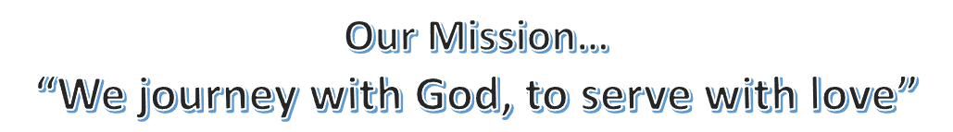
December 2024
Pastor Paul Busekist
Traverse City, MI 49686
(231) 947-9880
Website: www.bethlehemtc.org
Email: bethlehem@bethlehemtc.org
Building Hours:
Monday – Thursday, 9am to 2:30pm
Office Hours:
Monday – Thursday, 9am to 2:30pm
Worship Times:
Sunday: 10 am Modern Worship including Communion with service Livestreamed on Facebook and YouTube
Sunday School/Adult Education: 9:15am
Third Thursday Worship: 7:00pm
Nursery open during worship service
Follow the STAR to Bethlehem!
Our Vision…
“As a community of believers journeying with God together, we at Bethlehem are called to serve with love by growing a premier youth ministry; enlivening Christian discipleship through lifelong learning, care, and spiritual formation; fostering a vibrant and inspiring worship experience; utilizing our natural setting and location for faithful creation care and outdoor ministry; and opening our doors always to be a “campus at the crossroads” for the mission and ministry of Jesus Christ.”

Slide 2
Let us build a house where love can dwell and all can safely live, a place where saints and children tell how hearts learn to forgive. Built of hopes and dreams and visions, rock of faith and vault of grace; here the love of Christ shall end divisions:
Refrain: All are welcome, all are welcome, all are welcome in this place.
- ELW 641 “All Are Welcome”
Dear Bethlehem brothers and sisters in Christ,
Advent is upon us, and it is a good kind of waiting…full of worshipping, working and welcoming. These words we might associate not only with this time of anticipation for the Christmas moment at Bethlehem, but indeed for ALL times of year. (God is good! All the time!)
In other words, this year’s Advent perhaps has more than one excitement in the air. First and foremost, we await Christ’s birth for the season and for all time (O Come, O Come, Emmanuel!) Looking back on our efforts in October and November, we can also rejoice having completed the first stages of our vision work together: (1) listening for God’s voice in scripture, in our congregation and our community; and (2) creating our new mission statement together on November 17th, namely:
“We worship, work and welcome…sharing God’s love and grace with all.”
Our new mission statement holds a lot of connections: Worshipping the Lord is the reason we gather to connect with God and one another each week. Working to bring the gospel to those around us both demonstrates a new quest for future outreach and shows our roots in the larger church and ELCA mission statement (“God’s work. Our hands.”) And finally…Welcoming – the first ingredient to ministry is making sure, as the hymn above states, that “All are welcome in this place.”
Now the next stage of Visioning begins: putting pen to paper more specifically on how our yet-to-be- written Vision Statement will come to fruition. What areas of ministry might Bethlehem strengthen, and what new endeavors will we cast a new vision to create. We’ll say more in the January STAR, but for now mark your calendars for 9am-3pm Saturday, January 11th, as our Vision Team invites all who would like to attend to an offsite Vision Retreat at the Liv Arbors “Community Hub” building. We ask if interested that you plan to be with us that whole day and R.S.V.P to Sherri Helman or Pastor Paul by Sunday, January 5th (i.e. the same day of our Congregational Budget Meeting) so we can be ready!
Until then, we gather for fellowship, dinner (5:45pm) and worship (7pm) each Thursday night this Advent, with our special “Blue Christmas” on December 19th - and of course on Christmas Eve at 4pm and 7pm. God is good, and Christ is coming soon! …Shalom, and Advent & Christmas blessings!
- Pastor Paul
PROSE FROM THE PREZ:
Jim and I were sad that we missed two wonderful events at BLC this past month: the Arts and Crafts Fair and the Fundraiser Breakfast for hurricane relief. We are so glad that both were a resounding success. We enjoyed seeing the Facebook photos….it was the next best thing to being there. Thanks to all who were involved in one or both of these amazing activities.
And in the continued spirit of “Thanksgiving” we now have the opportunity to extend an extra “thank-you” to our wonderful BLC employees. Usually we have tried to “sneak” this reminder into the STAR as an extra sheet, but with our new delivery system it just is not possible. So, here is the notification of a way you can show appreciation of our staff: Pastor Paul, Barbara, Phil, Alanna, David, Zeke, Tony. If you desire to participate in this year’s gift-giving please donate so your monetary offering arrives by Dec. 15 in any of the following ways:
1. Label an envelope with “staff gift” and place it in the offering plate/vase.
2. Give your gift to any council member.
3. Send your gift to the church and indicate “Attn: Dave Peppler” on the outside.
Thank you in advance for your generosity.
Christmas blessings to you and yours,
Cindy Monroe BLC Council President

Slide 3
FINANCIAL NEWS
October income was $29,793 compared to budgeted income of $28,641. We received $1,152 more than budgeted. Expenses were $46,367 compared to budgeted expenses of $29,903. This resulted in spending $16,464 more than budgeted. Key factors for higher expense were a third pay period in October ($5K), annual Temperature Control contract ($4K), sprinkler system repair ($2K) and timing of paving project ($5K). For the month, the church spent $16,574 more than we brought in. Note $10K of the overage was due to timing of payment…the expense was budgeted in a different month. It does not mean we spent $10K that was not anticipated and budgeted for.
Year to date income is $313,358 compared to budgeted income of $287,325. This resulted in the church receiving $26,123 more than budgeted. Expenses were $342,763 compared to a budget of $323,176. We have spent $19,587 more than budgeted. For the year the church has spent $29,405 more than we have brought in.
BLC ANNUAL BUDGET MEETING SCHEDULED FOR JAN 5 AFTER THE SERVICE: Please attend if you can. It is critical for you to be involved in knowing the financial status of our congregation and in voting to approve the budget for 2025. Copies will be available in church as soon as the proposed budget is approved by church council at its meeting on 12/17. If the service has to be cancelled due to bad weather on Jan 5, the meeting will be postponed to the following Sunday.
Time to join in singing Christmas Carols: This is the opportunity to bring BLC to some of our members who cannot easily come to BLC. We will go out in small groups to sing Christmas carols to those who have not been able to join us at church. Even if you feel you cannot sing, others have described this as one of the most meaningful activities of their Christmas season. Please set aside time after the service on Sunday December 22. We will plan to have a light meal before we venture out to share out carols.
Next Month at Safe Harbor!
As the holidays move closer, I want to thank you all again for the gifts of time and food you are planning for our Safe Harbor effort in the New Year. We’ll be serving Safe Harbor guests on Saturday, 25 January; Sunday, 26 January; Tuesday 28 January. Kitchen Teams will be led by Cindy Monroe, B.J. Christensen, and Tina Dohm and the crews they have recruited. Zeke will be entertaining one night and we are seeking more talent- guitar, keyboard, other… We will welcome congregational “treat” support from you with sign-ups right after Christmas. This is needed community outreach. This is heeding Christ’s command to serve our neighbors. All volunteers have been pleased with their experiences. Please contact me with any questions. Tom Rockne
Bethlehem Safe Harbor Coordinator M.231.631.0040
CHAIR YOGA: Chair Yoga will continues every Monday at 3:00 in the Fellowship Hall. Cost is $5.00 per person. It is slow paced stretches that helps with balance, flexibility and relaxation. Come and try it out.
Coffee and Cookies on Sunday Remember that treats and a drink on Sunday are appreciated by all. Please take a moment to sign up to bring cookies or some other tasty treat on the Sunday that works best for you. Or sign up to prepare the coffee to give our loyal volunteer Mary Ann Tanis a day off. Our final Sunday of the month will be a time when we join in the Fellowship Hall for this activity. We can sit at a table and chat with someone new while we munch on a treat. For this month it will be on December 29th

Slide 4
Advent Meals
BLC will be having meals prior to Advent Worship services.
The meal for December 5th will be Chili with hot dogs rolled in crescent rolls, salad, chips, dessert and beverages.
December 12th meal will be baked potato bar with all of the fixings, salad, dessert and beverages.
December 19th will be Blue Christmas and Phil Bossardet will be making a wonderful Christmas dinner with Red wine braised beef, Roasted acorn squash, Brussel sprout-parsnip medley, Cheddar mashed potatoes, Rich gravy, Apple- cranberry compote, Green salad, Dinner breads including some gluten free bread/rolls, > Desserts will be Connie Christopherson’s pies, also apple crisp.
The Fellowship Committee could use more help in providing the meals. If you would like to help please talk to Gail Goldsmith or call her at 231-633-2630.
Advent and Christmas Services
December 5: 7:00pm Holden Evening Prayer
December 12: 7:00pm Advent/Christmas Hymn Sing
December 19: 7:00pm Blue Christmas Service
December 24: 4:00pm Christmas Eve Candlelight Service with emphasis on Children (will be Live-streamed)
December 24: 7:00pm Christmas Eve Candlelight Service
A big thank you to all who have turned in Olesons’ slips. On August 29th, we received a check from Olesons for $190.86 for a year-to-date total of $397.46. Olesons’ slips never expire. Please continue to turn in your Olesons receipts to Bethlehem. Thanks so much!!! Also, the area for the Oleson receipts is in the lower cabinets below the mailboxes (under the A-B-Cs…). The cabinet door is marked with the receptacle inside. Unfortunately, we are no longer collecting the receipts from Family Fair.
CHRISTMAS TEA IS COMING! Our annual Christmas Tea will be held on Sunday, December 8th from 2-4PM. Our theme this year is 'Angels Unaware'. If any of you have angel decorations you would like to share with us that day, please let Nancy Ammann know. (946-8433) There is a poster and signup sheet in the Narthex with more information. A wonderfully blessed way to usher in the Advent Season!
December’s XYZ meeting will be on Friday, December 13th, at 12pm noon. We will be having a ham, so bring sides and desserts to go along with it! Our presenter in December will be Annie Solem from Thrive Medical Clinic (formerly the Pregnancy Care Center), sharing their most recent patient story video and their newly developed education resource for the faith community, “How to Be a Safe Place for Someone in An Unplanned Pregnancy.” We hope you can join us for lunch and a great presentation! All adults are welcome!
CHOIR NEWS: Choir rehearsals be on Tuesdays at 7:00 –December 3, 10. If you are interested in joining the choir, give your contact information to Cindy Monroe or any member of the choir and have them pass it on to our choir director, Tony Bero and he will get in touch with you directly. Or you can simply arrive at choir rehearsal on Thursday and we'll figure out how best to use your talents.
BOOK CLUB NEWS: The book club will NOT be meeting in December to discuss a book. The next meeting will be Wed, Jan 15 at 5:30. We will be reading “The River We Remember” by William Kent Krueger. The book club has previously enjoyed books by this author. Please join us in the Fellowship Hall if you like to discuss good books. Any questions can be directed to Cindy Monroe at cmonroe@chartermi.net.

Slide 5
VISIONING NEWS…GIVING THANKS FOR THE BODY OF CHRIST:
On Sunday, November 17, we concluded our third congregation conversation regarding our Vision!! Thank you so much for ALL who have participated as we have moved through the work this fall!! Your dedication and presence in this endeavor is so greatly appreciated!! We take “pause” now through the Advent and Christmas Seasons knowing we will continue after the first of the year. (See Pastor Paul’s page for more details for Janurary 11th.) As the schedule is formed and the next steps are planned, we will remain in contact publicizing the information in order that you are aware. Our work is not complete… for God’s work never is. However, we are well on our way thanks to the participation of so many!! Blessings to you in this Holiday Season! May it be a season of Holy Days for all!!
Your Visioning Team
Christian Care Giving
1 Thessalonians 5:11 Therefore encourage on another and build up each other, as you are doing. As a Ministry we are called to take care of each other. Our goal is to provide care for all of those in need and to make sure no one feels alone and not cared for by our congregation. You are loved and wanted by all of your church family. If we can help you or you know of anyone who has a need, please let me know. Peggy Burns cobaltblues2003@yahoo.com or 231 392 6913 If you would like to be a caregiver please let me know.
Are you grieving something from a death or something else? It could be any kind of loss, and it hurts. We have a place for you here at Bethlehem on the 1st Monday of the month from 3:30 to 4:30 and the 3rd Monday of the month from 5:30 to 6:30 in the Youth Room. The December dates are December 2nd and December 16th. If you have any questions, please contact Peggy Burns at 231 392-6913.
Christ In Our Home: Did you know that there is a large print version od Christ in Our Home? We are considering ordering this version along with our regular size but need to know if there is a need here. If you or someone that you know would benefit from using large print, please call the church office at 231-947-9880 or email Barbara at admin@bethlehemtc.org
Pancake Breakfast Fundraiser
Bethlehem Lutheran Church held a fund raiser for hurricane relief on November 9th. Phil Bossardet planned the event and was the head chef with his son Bob. Together they made pancakes, sausage and eggs. Other foods were donated, breads, fruit and juice.
54 people were served and donated a total of $2936. The funds were sent through Thrivent, who matched our dollars. For every $2 we sent they gave an additional $1. We choose Lutheran Disaster Response for the money to help the people in the southern United States who were devastated by the recent hurricanes.
Thank you for all those who attended and the many volunteers: Phil Bossarrdet, Bob Pierce, Alanna Steffunick-Boomer and Sammy, Kay Rumbach, Barbara Oster, Janet Landis, Patty Leibenguth, Dan and Laura Hahn, Mark and Kathie Bair, Nancy Ammann, Kristen Rivard, Diane and Doug Cunningham, Tina Dohm, Betty Rutila, Jay Pflasterer and Gail Goldsmith.
Thrivent provided the funds to purchase the food and paper products for the meal.

Slide 6
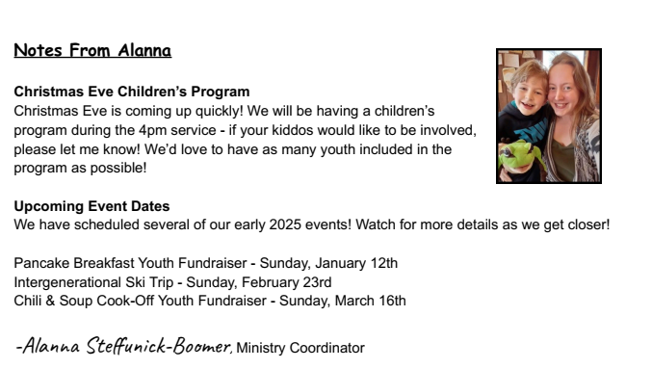
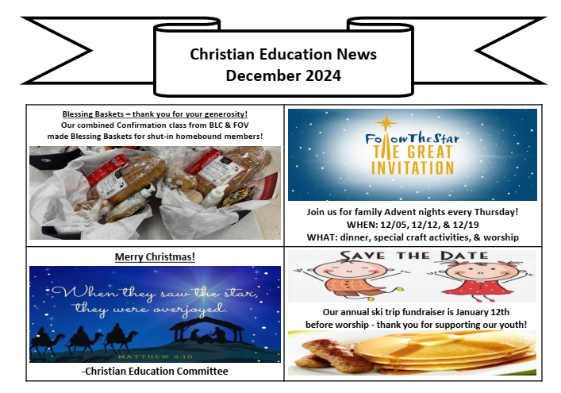

Slide 7
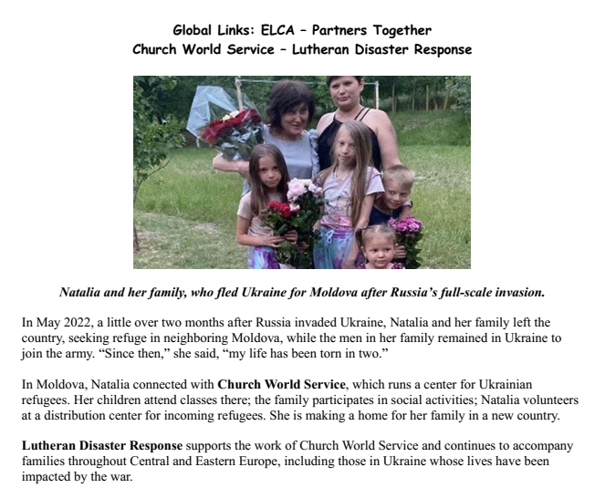
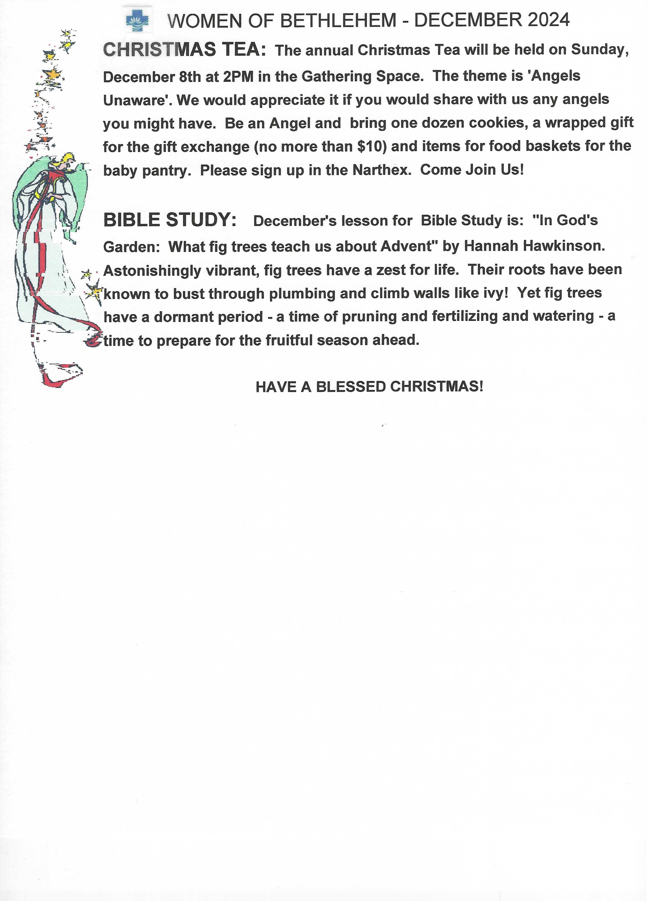

Slide 8
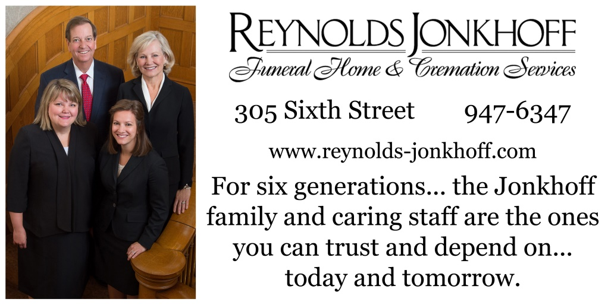
Monthly donation: 1/16 page $25; 1/8 $50; 1/4 $80. Pay for a year in full---get 1 Month Free
Questions??? Please contact Alanna Steffunick at 231-947-9880 or alanna.steffunick@bethlehemtc.org Make checks payable to BLC…put “Star Ad” on envelope.

Slide 9

Health Concerns*
The Power of Prayer
Richard Fernholz, Tom & Lee Miller,
Judy Fenton, Julie Lapeer, Milt & Carol Bowes,
Lynn Hoyt, Ron Hellenga, Cindy Hitesman,
John Stretlien, Harper Wiemerslage,
Sherry, Leroy Schlagel, Roy & Marilyn Dumond, Sean Rivard,
Brenda Denoyer and the Denoyer Family,
Patti McCracken, Sharon Vanmeter, Dale Thiel,
Margaret Hutchison, Carol Collins, Julie,
Patience Lambert, Dale & Cheryl Leider, Julie Barrett,
Jennifer Mowers, Debbie Knopf, Janet Burmeister,
Jim Rumbach, John Block, Bob Pierce,
Billie Thompson, Earl Manuel, Jack McCracken, Marianne
Norm Fred, Betty Sheftall
French Manor South: Brenda Denoyer
Evergreen Cottage: Milt & Carol Bowes
Hospital Visits: Please let the church office know if you are going into the hospital for a scheduled procedure or an emergency so Pastor Paul can visit you.
Prayer Requests:
•Prayer Chain: Please contact Jan Stretlien at jstretlien@gmail.com or 231-947-3265
•Prayers read from the altar: Please call the Administrative Assistant in the church office 231-947-9880 or email admin@bethlehemtc.org
Are you checking for the latest BLC updates at: www.bethlehemtc.org?
You saw Norm and others take the photos...be sure you see them at www.bethlehemtc.org!
Good News...and great news...at www.bethlehemtc.org...
Looking for a link to last month’s full Council minutes?
Type this address/url into your web browser to get the latest approved minutes from Council (or call the office for a copy:
bethlehemtc.org/Council-Minutes

Slide 10
BLC Contacts
Church Office
Pastor Paul Busekist paul.busekist@bethlehemtc.org
Admin. Asst., Barbara Oster admin@bethlehemtc.org
Bookkeeper, Phil Anderson bookkeeper@bethlehemtc.org
Tony Bero, Music Director bero.tony@gmail.com
Alanna Steffunick, Ministry Coordinator Alanna.Steffunick@bethlehemtc.org
Website www.bethlehemtc.org
Church Council
Cindy Monroe, President president.council@bethlehemtc.org
Gail Goldsmith, Vice President vicepresident.council@bethlehemtc.org
Paul Wiemerslage, Secretary secretary.council@bethlehemtc.org
Dave Peppler, Treasurer treasurer.council@bethlehemtc.org
Jim Monroe, Financial Sec. financialsecretary.council@bethlehemtc.org
Peggy Burns, Christian Care Giving christiancaregiving.committee@bethlehemtc.org
Tina Dohm, Christian Ed. christianeducation.committee@bethlehemtc.org
Gail Goldsmith, Fellowship fellowship.committee@bethlehemtc.org
Cindy Monroe, Membership/Evangelism membershipevangelism.committee@bethlehemtc.org
Doug Cunningham, Property property.committee@bethlehemtc.org
Maureen Bauer, Personnel personnel.committee@bethlehemtc.org
Jana Rockne, Safety & Security
Scott Farley, Stewardship stewardship.committee@bethlehemtc.org
Denice Bossardet, Worship and Music worshipmusic.committee@bethlehemtc.org
Tina Dohm, Youth/Y2A youth.committee@bethlehemtc.org
Pastor Paul Busekist paul.busekist@bethlehemtc.org
If you have an interest in serving on any of the above Committees,
Please contact the Committee Chairperson(s).

Slide 11
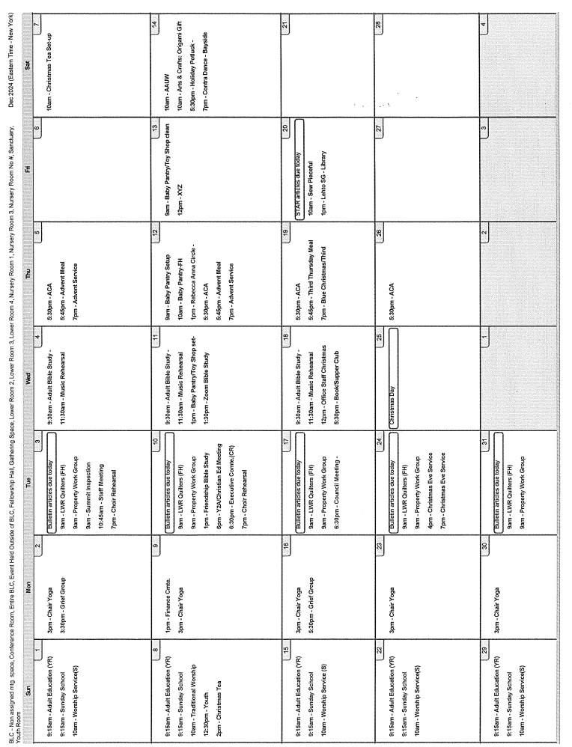

Slide 12

Lots of cool information inside
Pr Paul’s Page
Council President’s notes
Council officers and committee liaisons
Visioning team news
Choir News
Safe Harbor
Christmas Caroling
WELCA Christmas Tea
Book Club changes
XYZ News
Advent Meals
Advent and Christmas services
Third Thursday / Blue Christmas
Upcoming Annual Budget meeting
Chair Yoga
Notes from Alanna
Christian Education News
Financial News
ELCA Global Links
Women of Bethlehem 2024
The Power of Prayer
Bethlehem Lutheran Church (ELCA)
1050 Peninsula Drive
Traverse City, MI 49686
www.bethlehemtc.org
231.947.9880

