Slide 1


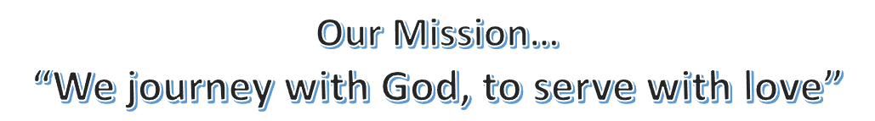
August 2023
Pastor Paul Busekist
Traverse City, MI 49686
(231) 947-9880
Website: www.bethlehemtc.org
Email: bethlehem@bethlehemtc.org
Building Hours:
Monday – Thursday, 9am to 2:30pm
Office Hours:
Monday – Thursday, 9am to 2:30pm
Worship Times:
Sunday: 10 am Modern Worship including Communion with service Livestreamed on Facebook and YouTube
Sunday School/Adult Ed/Third Thursday Worship: Will resume in the Fall
Nursery open during worship service
Follow the STAR to Bethlehem!
Our Vision…
“As a community of believers journeying with God together, we at Bethlehem are called to serve with love by growing a premier youth ministry; enlivening Christian discipleship through lifelong learning, care, and spiritual formation; fostering a vibrant and inspiring worship experience; utilizing our natural setting and location for faithful creation care and outdoor ministry; and opening our doors always to be a “campus at the crossroads” for the mission and ministry of Jesus Christ.”

Slide 2
Pr. Paul is on Sabbatical and wishes you all a wonderful summer.
In his stead will be favorite passages from scripture
Psalm 121
A Song of Ascents
1 I lift up my eyes to the hills—
from where will my help come?
2 My help comes from the Lord,
who made heaven and earth.
3 He will not let your foot be moved;
he who keeps you will not slumber.
4 He who keeps Israel
will neither slumber nor sleep.
5 The Lord is your keeper;
the Lord is your shade at your right hand.
6 The sun shall not strike you by day,
nor the moon by night.
7 The Lord will keep you from all evil;
he will keep your life.
8 The Lord will keep
your going out and your coming in
from this time on and for evermore.
The First Words from your New Council President:
I follow in the footsteps of many council presidents who have led us very well. I pray that I am worthy of this new task, and I ask for your prayers to do the best possible job as council president for this wonderful congregation.
I had thought that I would not be chosen for this position before I retired from my “regular” job. But we know, it is in God’s time---not our time. And, as we have often heard in church, “God does not call the equipped, He equips the called.” I am thinking, He may have given himself a bigger job than He wanted.
Seriously, I will always focus on my favorite bible verse, Phil 4: 13 “I can do all things through Christ who strengthens me.” And with the help of each of you, I believe that this congregation can continue to grow and nurture ourselves, our community, and beyond. Please be open to new ideas and adventures.
Blessings, Cindy Monroe

Slide 3
SHEPHERDING A SABBATICAL
Oh my, here we are in August! Sabbatical is almost over. It seemed like it took forever with a lot of coordination to finally arrive and now it’s almost over. We hope everyone has enjoyed the activities. We pray Pastor Paul, Meredith and Parker have had a wonderful summer to rest, re-energize and refresh. We look forward to their return to Bethlehem.
Upcoming activities in August include:
Cookie decorating with Sandy Parkinson on Wednesday, August 8th, from 6:00 to 8:00 p.m. in the kitchen at BLC. Come and learn to decorate cookies and take some home to enjoy. Please bring a sheet pan or shirt box to carry your cookies home. You may consider leaving 1 or 2 cookies to give to families who come to the Baby Pantry on Thursday.
Ukulele Class starts on August 13th right after church with Zeke Clemens. The participants will have a few lessons during the week to perform at the Welcome Back Lunch for Pastor Paul.
Painting workshop at Hang Workshop on Sunday August 13th from 4:00 until 6:30. Barbara Wright has sent out an email to all participants to pick out the painting you would like to do. Snacks will be provided.
Chair Yoga is continuing on Mondays at 4:00 in the Fellowship Hall. There is interest in continuing this class through the fall, if this is arranged, participants will need to pay on their own. See Gail Goldsmith if you are interested.
Pickle Ball with Dale Wentzloff is Monday, Wednesday and Thursday from 4:30 until 5:30 at the courts by the dog park off of Division Street. Dale will continue classes until the end of August. He will be out for a couple of days and has been in contact with the participants.
Welcome Back Lunch right after church on August 20th. Detroit Wing Company is catering the lunch with chicken wings, a variety of sauces, coleslaw and cornbread bites. This will also be our 4th and last Sundaes on Sunday for the summer.
We would love for everyone to wear their new BLC shirts to church to welcome Pastor Paul back. If you don’t have a new shirt, if you could wear a white shirt, that would be wonderful.
There have been evaluations to fill out at most activities. Thank you for completing those. If you would complete the survey on line for activities, this will assist in the visioning process when Pastor Paul returns. The link is https://www.surveymonkey.com/r/8NB35RM.
The following is the pulpit supply in Pastor Paul’s absence for the month of August:
Date Preaching Worship Leader Communion
August 6th Sherri Helman Cindy Monroe no
August 13th Pastor Christine Bright Pastor Christine Bright yes
August 20th Pastor Paul Busekist Pastor Paul Busekist yes
Peggy Burns will cover any pastoral care until Pr Paul’s return. Please call the office Monday through Thursday for any needs you may have. Barbara Oster has graciously said people may call her home phone after hours in cases of emergency that cannot wait until the next work day.
Thank you for all of your support for the Sabbatical. It was so important for Pastor Paul and for the congregation.

Slide 4
A big thank you to all who turned in Olesons’ receipts. We just received a check from them for $304.88. Last year received $651.20. Let’s see if we can do even better this year! Please continue to drop off your receipts at Bethlehem. Please note they do not expire. Thank you!
BLC Book Club: The BLC book club is taking a summer vacation!!!! Please keep reading and bring your suggestions back to the group on Sept. 26 or send them in advance to cmonroe@chartermi.net. We hope to share meals at our meetings again besides discussing wonderful books.
Contra Dancing by Bayside Travellers Contra dancing is similar to square dancing, and each of their dances feature live music by local folk bands. They will be back with us for dancing on August 12th and monthly dances through the rest of the 2023 year. All are welcome to attend, no partner or experience is necessary! The dances are by donation. For more information or further dates, please reach out to Alanna at alanna.steffunick@bethlehemtc.org
Food Pantry: HELP!!! Our outdoor food pantry has finally been found by those in need and there is hardly anything left in it!!!! Please take some time and buy some extra staple items when you go shopping. The shelves in the pantry are labeled. You can place your items right in the cupboard or you can bring them inside church and leave them on the CARE table in the coat room.
The Two Wednesday Bible Studies: Adult Bible Study and Zoom Bible Study along with the Sunday School and Sunday Adult Education are taking the summer off and will resume in September.
Night of Harmony: For those of you who really enjoyed our musical guests on June 11, the entire Cherry Capital Chorus of Barbershop music is presenting a performance on Aug 5 at 7:30 pm at the Presbyterian Church. Admission is $20 for adults and $10 for students
Spotlight on Zeke: So many of us enjoy Zeke’s talents with religious music, but did you know that he plays other kinds of music at various locations around town?
Here is a list of his engagements in the next month that are close to TC:
Tues 8/15—Bel Lago Winery in Cedar at 5:00
Sat 8/19 & Thurs 8/24—Brady’s Bar outside on the patio at 6:30
Sat 8/26—Bel Lago Winery in Cedar at 3:00
IMPORTANT NOTICE: We often find the front door and/or the kitchen door unlocked when there is no one in the building. Please be sure that the doors are locked when you leave.
Two Thank You notes received:
From Sarah Denton – Thank you so much for the card and Target gift Card. The love and kindness shown has filled my heart so much. Thank you. BLC has always, and will always hold a very special place in my heart. I’m excited for Sunday mornings on a lake kayaking, or getting all the sleep between babysitting jobs, and coming to BLC to enjoy seeing everyone. Thank you all so much for everything, I appreciate and love you all! With all my love, Sarah Denton
From the Family of Frank Watz, Sr – Dear Bethlehem Friends, Thanks to all who came to visit, the gift of the teddy bear, all who sent cards or attended Frank’s Memorial service – we are truly grateful. Most of all, thank you for your love and prayers.

Slide 5
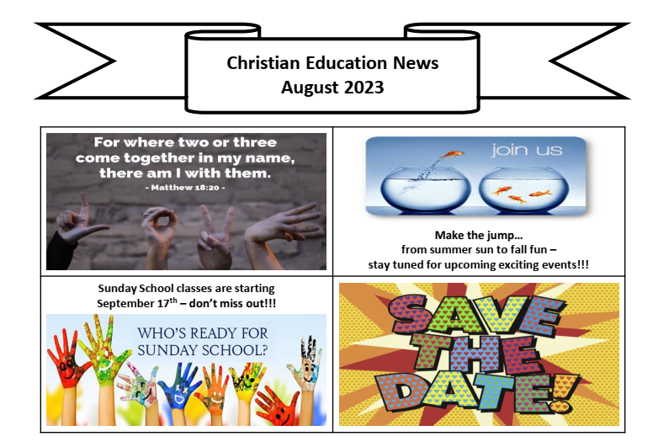
Notes from Alanna
THANK YOU, Parking Lot Fundraiser Volunteers! BLC hosted the annual Parking Lot Fundraiser on July 1st, 2nd, and 4th. All the proceeds from this fundraiser go toward supporting Bethlehem’s youth. This year, the fundraiser was very successful once again - in total for those three days, we earned $3,028!
Youth Volunteers:
Makena Dohm Aleah Graf Hunter Antol Harper Wiemerslage
Lincoln Dohm Jacob Graf Sammy Steffunick
These kids showed such great responsibility, teamwork, and leadership as they worked the entrance of the parking lot. They took money from customers, made change, gave directions, communicated with each other, and worked as a team to make sure cars were moved through quickly and efficiently. They really took this opportunity and ran with it, and did such a wonderful job. I am so proud of you all!!!
Adult Volunteers
Erin Word Mark and Kathie Bair Scott Farley
Forrest Bowling Martin Graf Shawn Antol
Frank Wall Norm Fred Sherri Helman
John Halstead Paul and Jessica Wiemerslage Tina Dohm
Kay Rumbach Randy Eisemann Tracey Moyer
Linda Hansen Renee Wells
All of the work that these adult volunteers put in is so appreciated. From putting up/taking down signs and barriers, to directing cars, to answering questions, to filling in wherever needed, you all kept this fundraiser running smoothly, and made sure that the kids had a safe place to work and volunteer!
Thank you to everyone who volunteered for this event! I appreciate all of you so much. Special thanks to Norm Fred and Frank Wall, who also supervised the parking lot on July 8th in addition to volunteering for normal fundraiser days. Your care and love for the church is appreciated. Pictures from the fundraiser can be seen on BLC’s website and Facebook page. Thank you, everyone! -Alanna Steffunick, Ministry Coordinator

Slide 6
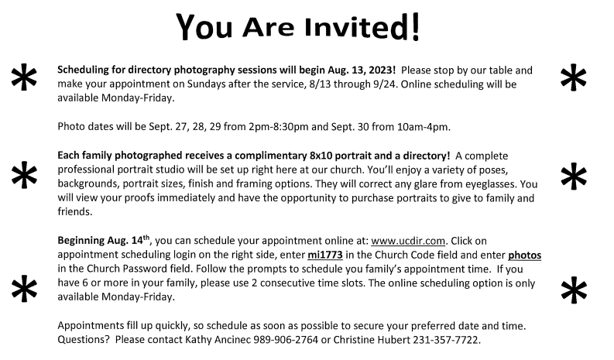
Good Samaritan “Fund”raiser: During the month of August, we will kick-off our Good Samaritan “Fund”raiser with our Envelope Wall. Each envelope in the series of 1-50 will represent a donation amount. So, if the first envelope is available for a $1 donation, the 33rd envelope is available for a $33 donation and so on. We ask that you remove the colored envelope of your choice from the board, if you’re interested in participating, and then put your donation into the inside envelope and return it to the church by putting it into the Sunday service collection plate, placing it into the mailbox of our bookkeeper, Phil Anderson, or mailing it back to the church. A reminder that the Good Samaritan Fund is one of our local outreach initiatives that allows us to be able to help our local residents when there may be a need for assistance with food, gas, a doctor bill, etc. We have been lucky in the past to help many and hope that you will help us build back this dwindling fund. Please, if paying by check, make payable to Bethlehem Lutheran Church with Good Samaritan fund in the memo line.
FINANCIAL NEWS
June income was $35,467.75 compared to budgeted income of $33,769 resulting in receiving $1,698.75 more than budgeted. Expenses were $37,944 compared to budget of $35,168 resulting in spending in $2,776 more than budgeted. On a cash basis expenses exceeded income by $2,476.25.
Year to date income was $181,387.96 compared to budgeted income of $183,919 resulting in receiving $2,531.04 less than budgeted. Expenses were $189,889.13 compared to budget of $194,392 resulting in spending $4,503.67 less than budgeted. On a cash basis expenses exceed income by $8,501.17

Slide 7

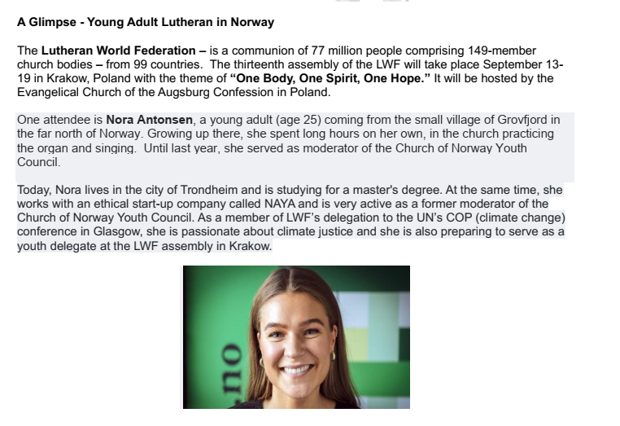
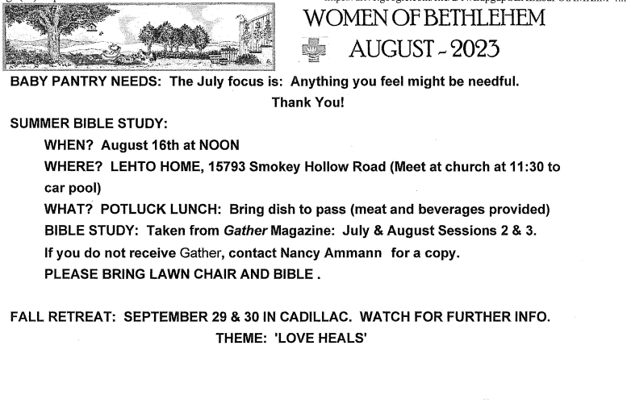

Slide 8

Health Concerns*
The Power of Prayer
Richard Fernholz, Nancy Smith, Tom & Lee Miller,
Margie Whitney, Ellie Tacke, Judy Fenton,
Julie Lapeer, Alvin Kober, Milt & Carol Bowes,
Lynn Hoyt, Tom Woodworth,, Dan Deutsch,
Molly Eastman, John Stretlien, Ron Hellenga,
Russ Luttinen, Sherry, Leroy Schlagel,
Roy & Marilyn Dumond, Sean Rivard,
Brenda Denoyer and the Denoyer Family,
Patti McCracken, Sharon Vanmeter,
Margaret Hutchison, Carol Collins,
Patience Lambert, Dale Leider, Craig Bauer,
Jennifer Mowers, Debbie Knopf,
Gail Goldsmith, Beverly Richardson
French Manor South: Brenda Denoyer Grand Traverse Pavilions: Margie Whitney Evergreen Cottage: Milt & Carol Bowes
Boardman Lake Glens: Inge Thomas
Hospital Visits: Please let the church office know if you are going into the hospital for a scheduled procedure or an emergency so Pastor Paul can visit you.
Prayer Requests:
•Prayer Chain: Please contact Jan Stretlien at jstretlien@gmail.com or 231-947-3265
•Prayers read from the altar: Please call the Administrative Assistant in the church office 231-947-9880
Are you checking for the latest BLC updates at: www.bethlehemtc.org?
You saw Norm and others take the photos...be sure you see them at www.bethlehemtc.org!
Good News...and great news...at www.bethlehemtc.org...
Looking for a link to last month’s full Council minutes?
Type this address/url into your web browser to get the latest approved minutes from Council (or call the office for a copy:
bethlehemtc.org/Council-Minutes

Slide 9
BLC Contacts
Church Office
Pastor Paul Busekist paul.busekist@bethlehemtc.org
Admin. Asst. Barbara Oster admin@bethlehemtc.org
Bookkeeper, Phil Anderson bookkeeper@bethlehemtc.org
Tony Bero, Music Director bero.tony@gmail.com
Alanna Steffunick, Ministry Coordinator Alanna.Steffunick@bethlehemtc.org
Website www.bethlehemtc.org
Church Council
Cindy Monroe, President president.council@bethlehemtc.org
Paul Wiemerslage, Vice President vicepresident.council@bethlehemtc.org
Jana Rockne, Secretary secretary.council@bethlehemtc.org
Gary Ancinec, Treasurer treasurer.council@bethlehemtc.org
Jim Monroe, Financial Sec. financialsecretary.council@bethlehemtc.org
Jim Hinds, Christian Care Giving christiancaregiving.committee@bethlehemtc.org
Tina Dohm, Christian Ed. christianeducation.committee@bethlehemtc.org
Scott Schlagel, Fellowship fellowship.committee@bethlehemtc.org
, Membership/Evangelism membershipevangelism.committee@bethlehemtc.org
Chuck Ardingo, (not on Council), Property property.committee@bethlehemtc.org
Maureen Bauer, Personnel personnel.committee@bethlehemtc.org
Scott Farley, Stewardship stewardship.committee@bethlehemtc.org
Denice Bossardet, Worship and Music worshipmusic.committee@bethlehemtc.org
Tina Dohm, Youth/Y2A youth.committee@bethlehemtc.org
Pastor Paul Busekist paul.busekist@bethlehemtc.org
If you have an interest in serving on any of the above Committees,
Please contact the Committee Chairperson(s).

Slide 10
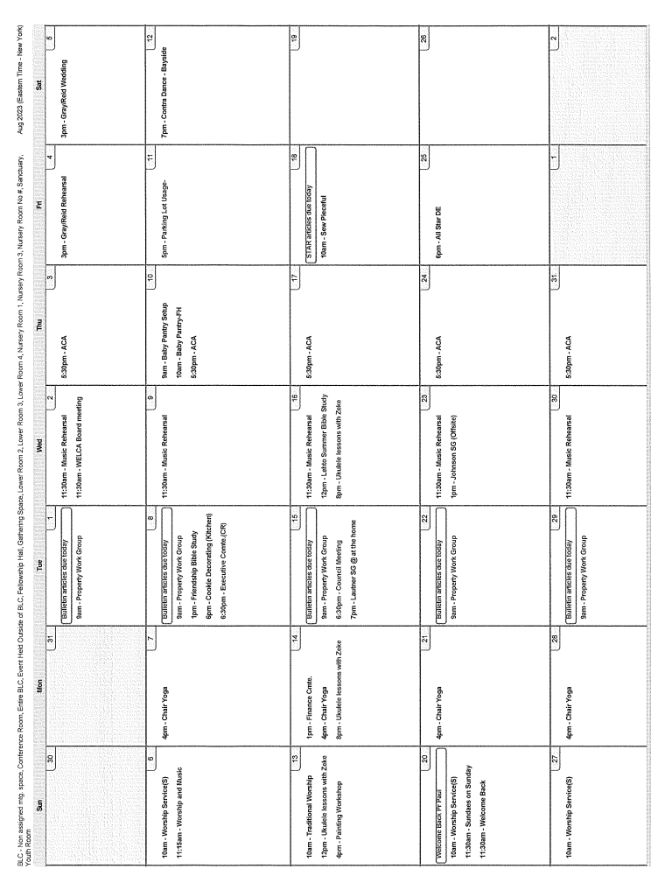

Slide 11
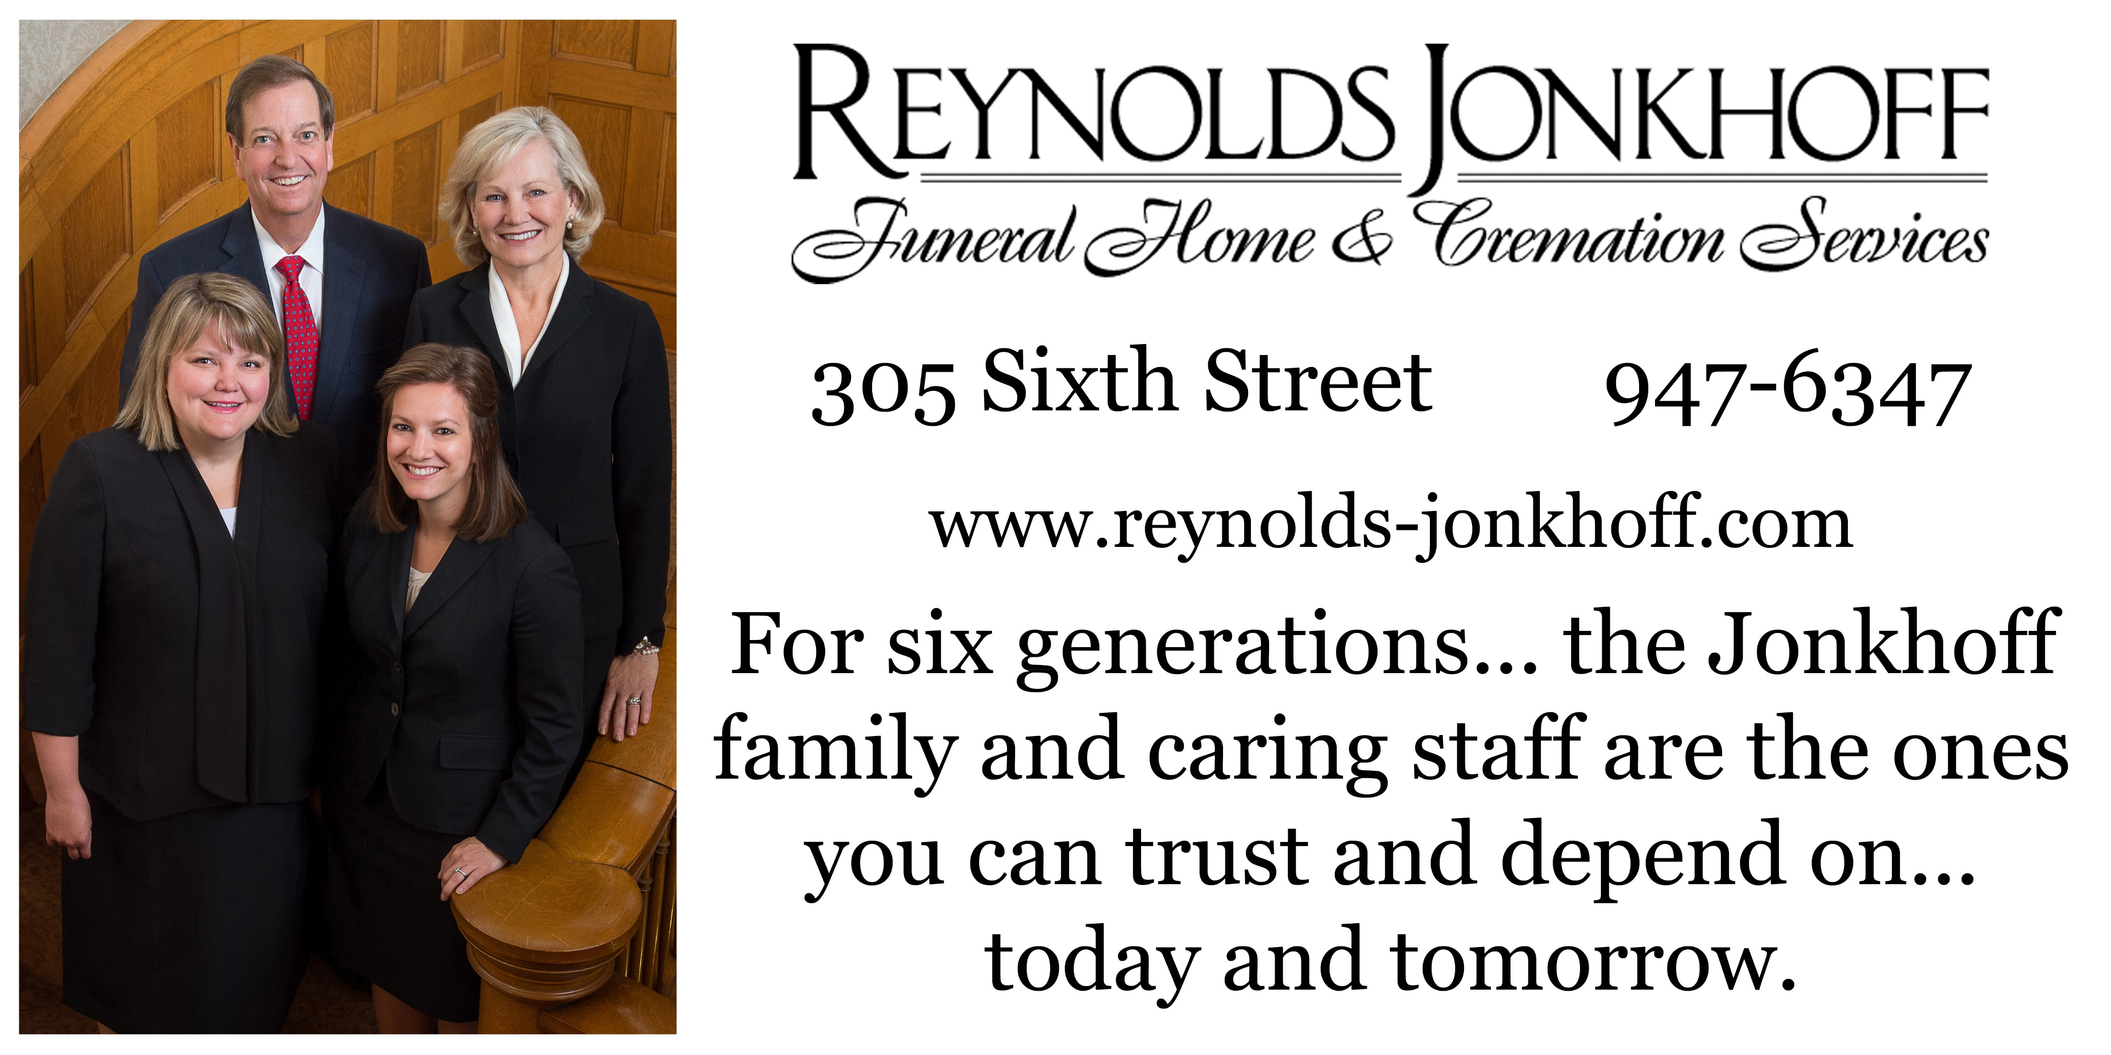

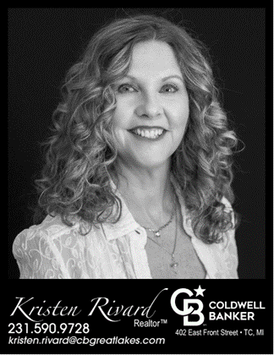
Monthly donation: 1/16 page $25; 1/8 $50; 1/4 $80. Pay for a year in full---get 1 Month Free
Questions??? Please contact Scott Farley 231-920-8333 or swfarley@charter.net Make checks payable to BLC…put “Star Ad” on envelope.

Slide 12

Lots of cool information inside
Pr Paul’s Page
Council President’s notes
New Council officers and committee liaisons
Sabbatical activities for August
Upcoming BLC Photo Directory info
Book Club info
Food Pantry info
Bayside Travellers Contra Dancing
Spotlight on Zeke
Notes from Alanna
Christian Education News
Financial News
ELCA Global Links
Women of Bethlehem 2023
The Power of Prayer
Bethlehem Lutheran Church (ELCA)
1050 Peninsula Drive
Traverse City, MI 49686
www.bethlehemtc.org
231.947.9880

