Slide 1


AUGUST 2017
Traverse City, MI 49686
(231) 947-9880
Website: www.bethlehemtc.org
Email: bethlehem@bethlehemtc.org
Building Hours:
Monday – Thursday, 9am to 3pm
Office Hours
Monday – Thursday, 9am to 3pm
Worship Times:
Sunday, August 13: One service at 10:00. see page 5 for details! Note: no Saturday service on the 12th!
Saturday: 5 pm Celebrate! Worship
Sunday: 8:45 am Traditional Worship
9:45 am Education Hr.
11 am Modern Worship
Communion at all services
Follow the STAR to Bethlehem!
Our Mission…
“We journey with God, to serve with love”
Our Vision…
“As a community of believers journeying with God together, we at Bethlehem are called to serve with love by growing a premier youth ministry; enlivening Christian discipleship through lifelong learning, care, and spiritual formation; fostering a vibrant and inspiring worship experience; utilizing our natural setting and location for faithful creation care and outdoor ministry; and opening our doors always to be a “campus at the crossroads” for the mission and ministry of Jesus Christ.”

Slide 2
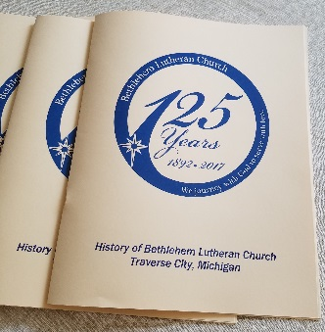
P
The STAR points to 125, and the Journey Continues!
astor
aul's
age
In my summation for the 125th Anniversary booklet (see picture and “snapshot” below, and get your copy soon!), I tried to make a snapshot of life at Bethlehem yesterday, today, and tomorrow. An impossible task, it still merits trying. That’s what we do in community (honor the past, celebrate the present, and plan for the future). But as we prepare for our final celebration of this anniversary on August 13th, perhaps we owe it to ourselves to “take stock” of the new blessings hopefully entering our midst in the days and weeks ahead:
An applicant for a newly-created part-time Youth and Outreach Director has approached Bethlehem, and she has been given high praise from those who have worked with her before. The Y2A committee has met with her and will formally interview the candidate on August 14th.
An applicant for a newly-created part-time Christian Education Coordinator position is in the process of being created (yes, this is a separate position by design, based on some of the things we have learned over the years, etc.) Our candidate is equally stellar, and we hope to know more soon.
Two new positions have been created, and by the time this STAR is printed Bethlehem hopes to provisionally hire Sharon Weller to dually function as Music Director and Administrative Assistant at BLC. She will work part-time as admin roughly 16 hours/week and be the “main” secretary with an auxiliary secretary (aka “Administrative Aide”) Renae Wells, to collaborate with Sharon approximately 8 hours/week.
BLC is still looking for a Custodian for 16 hours/week at the conclusion of the summer, when our interim custodian Caleb Kelly returns to college downstate.
We give thanks for all the new possibilities – staffing and otherwise – that Bethlehem is blessed with at such a crossroads of time and ministry. We also give thanks for the many people who continue to do amazing work at Bethlehem during this year of celebration (Mary Lou, interim secretary Peg Peppler, Sharon Weller, Zeke Clemons, David Warne, Linda Davis, and David Husser – to name a few!) Our many volunteers deserve much thanks (especially Suzanne Lehto!) as we reach this 125th milestone together.
As we move forward, may we keep our eyes on God’s word and work, and the neighbors we journey with…serving always with love.
In peace,
Pr. Paul
The Faithful Work of Many Hands (from the 125th booklet)
“O LORD…we are the clay, and You our potter;
And all of us are the work of Your hand.” (Isaiah 64:8)
When asked to write this concluding reflection for Bethlehem’s 125th, I remember thinking, “At best this will be a snapshot.” We might all say that our time together in this holy place is but a snapshot of Bethlehem’s larger history, a still frame of God’s love on this planet, and a mere moment in the story of ALL God’s people.

Slide 3
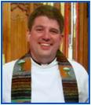
But our time here is indeed very important. Just as it takes much love and effort to make any friendship last a lifetime, it also takes those very attributes to foster the life of a congregation for 125 years. Time can help a people remember what is important and keep “the good stuff” at the forefront. And time can also put distance between us and even our oldest living memories. Fifty years ago, there were no-doubt members of Bethlehem who could have said they remembered being part of this congregation when it was born.
Twenty-five years ago there were likely a few Bethlehemers old enough to say they were baptized as infants in the original church on Washington Street. But now we have passed the limits of individual memory. No 125-year-olds remain to tell us how it was when Bethlehem began. Instead, we must now point to our collective memory, our historians’ accounts, and the traditions, beliefs and manner of being that has carried us this far…with God’s grace.
What has happened since BLC’s inception? This booklet has provided much of that history, to be sure. What has happened in the larger world? A July, 2014 Wall Street Journal article (entitled “125 Years of Change in the U.S. Economy – and the Dow”) puts our collective human “advancement” in perspective:
“Indeed, the business world of 1889 today seems almost something from an alien planet. Offices were nearly totally masculine preserves. About the only jobs for women outside the home were as teachers, nurses and telephone operators. Almost all large corporations were run by members of the WASP establishment. Ledgers were mostly handwritten, as were most invoices and even many contracts. There were no standardized rules for keeping books, and almost no government regulation of business.”
The article goes on to explain how the turn of the 20th century brought us the innovations of the telephone, typewriter and others – transforming society in the 1900s in much the same way that Martin Luther and the invention of the printing press transformed the world in the 1500s. We just so happen to be celebrating our 125th anniversary as a congregation in the same year we celebrate the 500th year of the Protestant Reformation. And as we look to this 21st century, we point to innovations in technology (the internet, smart phones, and social media, etc.) as well as innovations in our own Christian worship (audio/visual, contemporary music, and a renewed sense of care for God’s creation) to name only a few. We can also point to innovations in the scope and collaboration of the larger Lutheran Church to which we belong – the relatively new Evangelical Lutheran Church of America (est. 1988) – which turns 30 next year. The ELCA at heart is a church body who sees our Christian neighbors as partners in ministry. And like our BLC mission statement (“We journey with God, to serve with Love.”) the ELCA’s mission statement is concise and powerful (“God’s Work. Our Hands.”) At Bethlehem those words have never been more true. The hands that have built and sustained this congregation remain faithful – thankful for the past, but moving toward the future – doing the work of God’s ministry, together.
I thank you for the continued opportunity to serve with you here at Bethlehem. Like a masterful carpenter, the skillful hands of Christ(ians) have built something special in this place, and thanks to our Master Potter we remain in the Spirit’s guidance and formation. We continue in faith, and peace, always.
-Pr. Paul Busekist
WASP: White, Anglo-Saxon Protestant https://www.wsj.com/articles/125-years-of-change-in-the-u-s-economyand-the-dow-1404763584

Slide 4

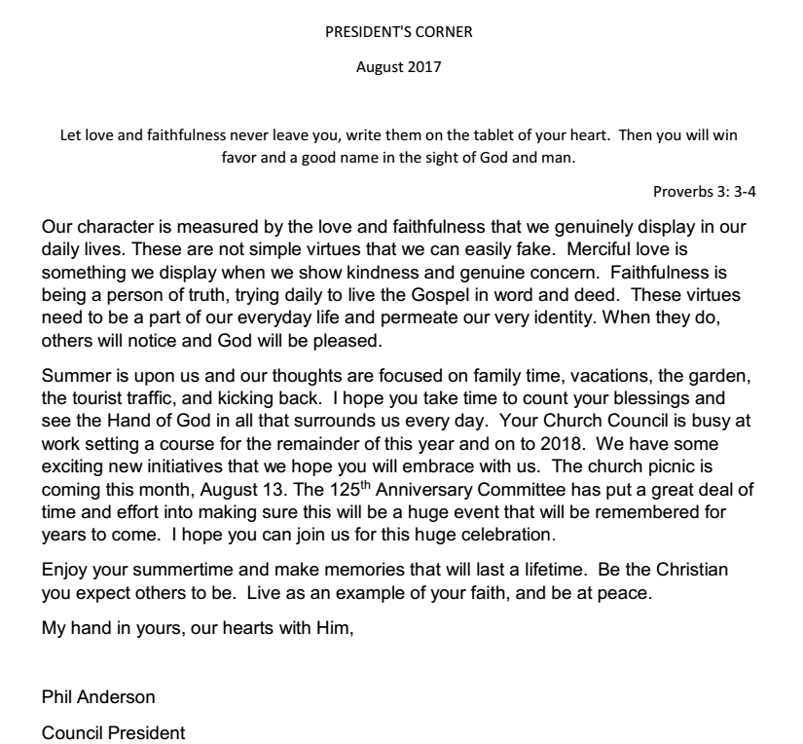

Slide 5
TREASURER UPDATE
Unfortunately the final July budget numbers are not available as of the date of this publication. July numbers will be included in the Sunday bulletin when available. Work is beginning on the 2018 budget with the various committees submitting their input for review in September. We plan an initial review in September, a second review in October with finalization in November for presentation to the Congregation in December. Stay tuned for more information as the year progresses.
Year | 2015 | 2016 | 2017 YTD thru 6/30
Congregation Contributions | 323,920 | 339,865 | 164,839
Avg. Attendance (1) | 165 | 160 | 166
Avg. Attendance w/o Palm Sunday & Easter | 161 | 156 | 155
Note Avg. Attendance is shown including Palm Sunday and Easter as well as without (w/o) those services. The 2017 Easter service was very well attended.
Funnel any budget questions to myself or Mary Lou Deutsch at bookkeeper@bethlehemtc.org.
Dave Peppler - Treasurer
Proper use of the BLC Tax Exempt Number
Just a friendly reminder—the use of BLC’s tax exempt number is solely for BLC sponsored events. Individuals holding private, non BLC sponsored events in BLC space should never use the BLC tax exempt number for food or other items. Improper use of the Gordon Food Service Store has been noticed this year. Contact Mary Lou Deutsch (Bookkeeper) or Dave Peppler (Treasurer) if you have any questions.

Slide 6

ANNIVERSARY CELEBRATION
WORSHIP/PICNIC IN THE PARK-AUGUST 13, 2017
Plans for this year of celebration have been in the works since November, 2015. We as a Task Force are thankful for all the participation in the various activities. I am thankful for a dedicated group of workers on the Task Force as well. Now for the finale!
August 13, 10:00am - about 2:00pm
at the CIVIC CENTER (Rain? Meet at church)
Worship: 10-11:30ish
Lunch: 11:30-12:30ish
Picnic Games for young and old after the luncheon
(Bocce Ball, Cornhole, Face Painting, Egg Toss, etc.)
ALL-PLAY SOFTBALL GAME: about 1pm
Tickets: be sure to bring yours if you want to eat. We are expecting 176 people! Bottles of water will be our drink of choice. BYOC(coffee) if you wish.
Wear: comfortable “picnic/play” clothes
Bring: a chair or blanket for worship time .... some may sit on chairs if we run out of picnic table space.
ALSO, for games, please bring your softball gloves for our family, fun “No Inning” Softball Game!
Now, we need some EXTRA HELP:
SERVERS - to dish up food (11:30)
CLEAN UP CREWS - after lunch to remove food; after everything, general clean up*
So, be prepared for a good day to enjoy the blessings God has given us together as a church family!
------------------------------------------------------------------------------------------------------------------
* I CAN HELP:
Phone
Server: _____________________________________________________________
Food clean up: ________________________________________________________
General clean up: ______________________________________________________
(Put in the offering plate or put it Suzanne Lehto’s mailbox. Thanks!)
Come and join us! Any questions, call Suzanne (223-7187)

Slide 7


SHOP AT FAMILY FARE AND HELP RAISE MONEY FOR QUILTS!!
Shop at Family Fare, 905 E. 8th Street here in Traverse City and help raise money for quilts!
To warm others with more than a prayers,
Save register receipts when you shop Family Fare!
Lutheran World Relief quilters need help from you.
Bring Family Fare receipts to us that you could do.
This helps raise money for the supplies it will take
For fabric, thread, and shipping necessary for the quilts we make!
Questions? Please call Sandra Osgood at 231-938-5930
Book/Supper Discussion Group
We meet from 5 to 7 pm on the 4th Tuesday of the month Join us, and if you have any questions, please contact Ellie Long at
935-4595.
Aug. 22 LaRose by Louise Erdrich (novel)
Sept. 26 The Nightingale by Kristin Hannah (novel)
Oct. 24 The Reformation 500th celebration—variety of sources
Nov. 28 Small Great Things by Jodi Picoult (novel)
Dec. 5 Christmas Potluck
Jan. 23 Last Bus to Wisdom by Ivan Doig (novel)

Slide 8
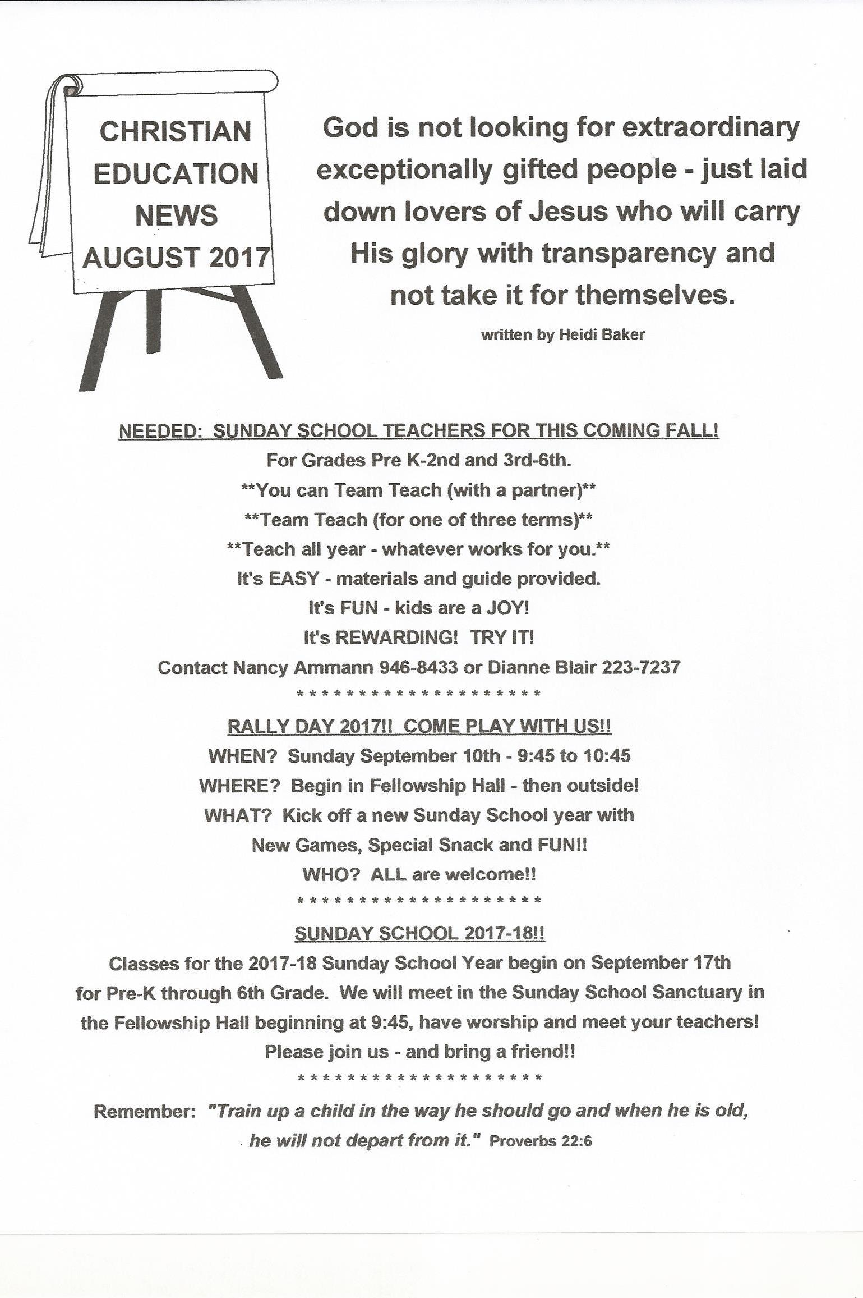

Slide 9
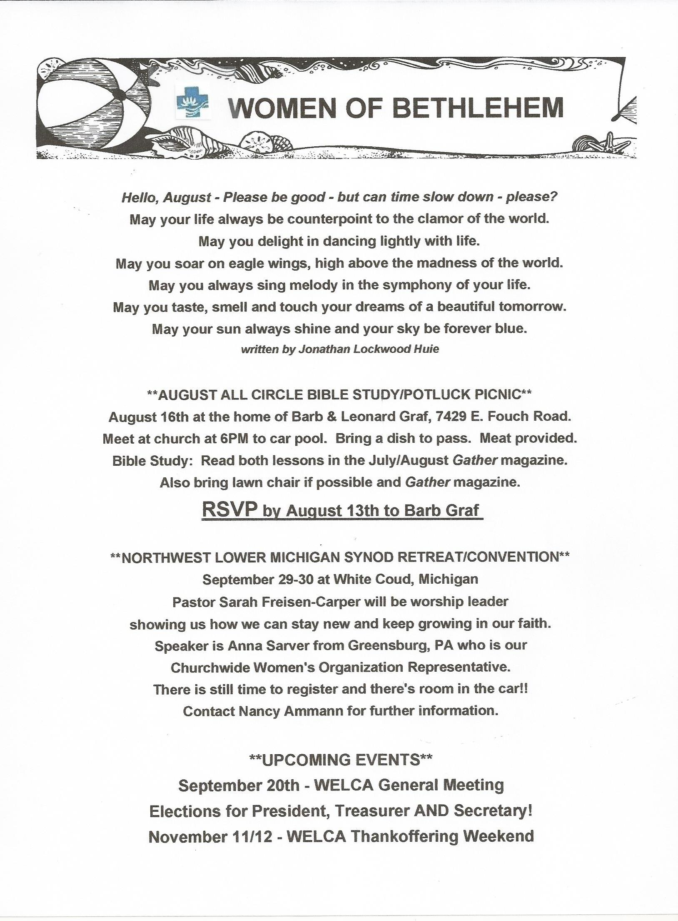

Slide 10
Worship & Music Fundraiser—ReSale Shop in the Fellowship Hall!

Slide 11



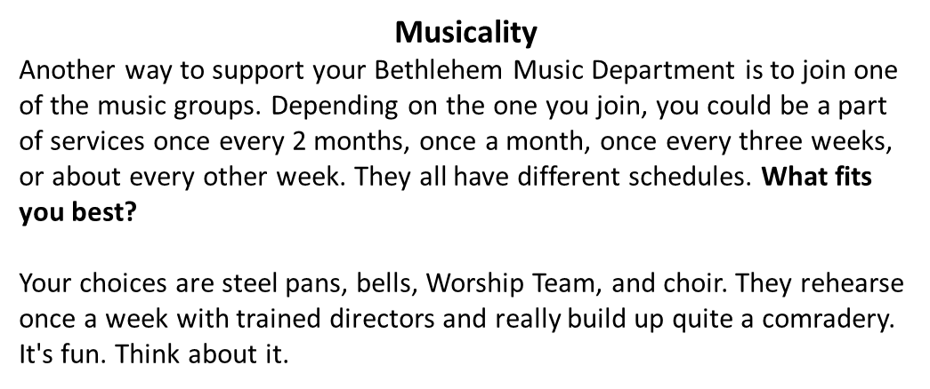
BETHLEHEM’S 6th FALL FAMILY CAMPOUT!!
Come one, come all. Calling all families to Bethlehem’s 6th annual Fall Family Campout to be held at Turtle Lake Campground, Beulah, on September 15, 16 & 17.
Food, fun, fellowship, campfires, swimming, fishing, s’mores are a few of the activities we will be doing. Turtle Lake Campground is located about 20 miles from Traverse City. It is a good way to get to know people better. Join us for a Saturday potluck, if you cannot come for overnight. For more information and/or a map, contact Barb or Leonard Graf at 231-946-5120. Kayak and canoe rentals available!
In honor of Bethlehem’s 125 year anniversary the worship and music
committee would like to restore the custom of honoring new members of the family of God with a rose at the Altar. Those who wish to celebrate their new child or grandchild can contact committee chair, Barbara Oster at: beo6475@yahoo.com or via phone 668-7038. The cost is $10.00 to be submitted to the church office,
or labeled as such and placed in the collection plate. The rose and
vase can be taken by the family after the 11:00 service on Sunday.

Slide 12
Worship Servants Needed…Please help!
“Your talent is God’s gift to you. What you do with it is your gift back to God.
Leo Buscaglia
Recently, three BLC members volunteered to be Lectors for our church services. They are an 11-year old, a busy Oncologist and a 95-year old, so if they can volunteer, you can too.
There are many opportunities for our members to be a part of any of BLC’s three services. Some are “in front of the congregation” and many are behind the scenes. With more volunteers on the list for each worship team, the rotation could be every 4 – 6 weeks more or less. We also have music teams that could use your voice or musical skills. Please prayerfully consider joining one of these worship/music teams:
Altar Guild: Prepares the altar for worship and Communion (one group of two people per weekend)
Assisting Ministers: Assists the pastor during the worship service and helps serve Communion (one per each of three services)
A/V Team: Sits in the balcony & manages the weekly “Screen announcements” and worship power point presentations (Sat. 5pm/Sun. 11am)
Lectors: Reads the Scripture lessons at worship services (one per each of three services)
Hospitality: Greets people at the door to the Sanctuary and hands out worship folders (groups of two people each for the Sat 5pm and Sun 8:45am services and groups of four people for the Sun 11am service)
Bell Ringers: Rings the BLC bell in the Gathering Space at the beginning of the service (one per each of three services)
Welcome Table: Greets people as they enter the church from the parking lot and assists visitors with the layout of the church (coat room, restrooms, nursery, Fellowship Hall, etc) (one or two per each of three services)
Worship Assembly and Sanctuary Preparation: Assembles the weekly worship folder and prepares the Sanctuary (one group of two people per weekend)
Counters: Counts the weekly offering collection. (Teams of three or four will rotate on a monthly basis)
Adult Choir: Sings at different services each month. Rehearses weekly, except for summer months
Hand Bell Choir: Plays approximately once per month in a Traditional and Modern service. Rehearses weekly, except for summer months
Worship Team: Leads music once a month at the Celebrate! And Modern services. Rehearses weekly, year round
Steel Pans: Plays once a month at various services, mostly during the summer months and Christmas services
For Worship Teams 1 through 8, please contact Barbara Oster at 231-668-7038 or beo6475@yahoo.com
For Counters (9), please contact Shelly McAllister at smcallister3@hotmail.com
For Music Teams (10-13), please contact our Music Coordinator, Sharon Weller at 231-947-9880

Slide 13

Monthly News
Each month, ELCA Global Mission sends out current news about Lutheran work across the world. Through the Internet, take some time to see how God is working in Lutheran churches in far off places. We are part of these efforts through BLC’s mission support to the North/West Lower Michigan Synod and through individual gifts by our members.
Evangelism in West Africa
In Senegal and The Gambia, two Lutheran churches are evangelizing to grow the church and expand their mission outreach. Watch the powerful video from these West African countries, where our brothers and sisters are daily witnesses by serving through word and deed. https://www.youtube.com/watch?v=MJqvvzfKY0I
Nepal Earthquake 2 Years Later
On April 25, 2015, around 11:55 a.m. local time, a 7.8-magnitude earthquake shook Nepal, with its epicenter approximately 43 miles from its capital city, Kathmandu. The earthquake was felt around the country, but the Kathmandu valley and western region of the country were hit hardest. Read how the ELCA is still helping rebuild communities in Nepal through Lutheran Disaster Response. http://blogs.elca.org/disasterresponse/nepal-earthquake-2-years-later/
'Liberated by God's Grace': The Lutheran World Federation 12th Assembly
From May 10-16, The Lutheran World Federation (LWF) gathered for its 12th Assembly in Windhoek, Namibia. Delegates from around the world - including a delegation from the ELCA - gathered around the theme “Liberated by God’s Grace.” This theme also frames the LWF’s approach to the 500th anniversary of the Reformation in 2017 by expressing two pivotal insights of Lutheran theology: the prevalence of God’s grace when it comes to justification and the gift of freedom that results from God’s transformative action. https://www.lwfassembly.org/en
Construction Progress in Juba, South Sudan
Thanks to support from the ELCA community and our local and international partners, the Lutheran center and clinic in Juba, South Sudan, is nearly complete! When finished, the center will provide both health and educational services to the community. However, this important project is only half funded. Watch this video to learn more, and to find out how you can help. https://www.youtube.com/watch?v=tJ7F2FITF-Q

Slide 14
YOUR HELP NEEDED !!!!!!
One of BLC goals this year is to energize our Membership and Stewardship efforts. Both Committees are in need of volunteers to make this happen. We are half way thru the year so the time to act is now. Please take a moment and ask yourself if you can find time to meet once a month and bring your ideas and talents to the team. Again, your support is critical to our success and makes all the difference. Contact the church office (947-9880) and leave a message for Dave Peppler or Phil Anderson, or e mail the church at diane.mcwethy@bethlehemtc.org if you would like to volunteer to help on either of these committees or would like more information on what is involved.
Help Wanted
Custodian (16 hrs/wk)
We are pleased to share that Caleb Kelly will serve this summer as interim custodian. Bethlehem still seeks a permanent part time Custodian. If you are interested, please contact the Church office at 947-9880, or talk to either Carl Lehto (custodian) or Leonard Graf (either position).
Carol Collins has a new address and would love to keep in touch with her BLC family!
Carol Collins
1100 Sunview Drive, Apartment 113
St. Johns, MI 48879
cjcollins80@charter.net
Are you checking for the latest BLC updates at: www.bethlehemtc.org?
You saw Norm and others take the photos...be sure you see them at www.bethlehemtc.org!
Good News...and great news...at www.bethlehemtc.org...

Slide 15
Health Concerns*
Jeri Boike, Richard Fernholz, Karen Anderson, Bob Jahnke,
Joe Berry, Carol Collins, Margie Whitney,
Ava Oleson, Thad Hellenga,
Kate Holtfreter, Virginia Fleming, and
Paul & Jessica Wiemerslagge.
Grand Traverse Pavilions: Walter Goff, Virginia Fleming
French Manor: Martha LaVire; Joy Givers: Hazel Lautner
Traverse Manor: Margie Whitney, Juanita Lautner, Jane Witkop
French Manor Lafranier: Jo Hasse
Culver Meadows AFC: Janet Hinds
Boardman Lake Glens: Ingie Thomas
Hospital Visits: Please let the church office know if you are going into the hospital for a scheduled procedure or an emergency so Pastor Paul can visit you.
BLC’s PRAYER CHAIN is always seeking partners in prayer.
More volunteers are needed for this crucial ministry.
For more information or to set the Prayer Chain in motion,
call Jan Stretlien @ 947-3265 or email jstretlen@gmail.net.
*If you would like your name, or the name of a loved one, to appear on this list which appears here and in the weekly bulletin, please call the church office at 947-9880.

Slide 16
BLC Contacts
Church Office
Pastor Paul Busekist paul.busekist@bethlehemtc.org
Admin. Asst. diane.mcwethy@bethlehemtc.org
Mary Lou Deutsch, Interim Bookkeeper bookkeeper@bethlehemtc.org
Sharon Weller sharon.weller@bethlehemtc.org
Website www.bethlehemtc.org
Church Council
Phil Anderson, President president.council@bethlehemtc.org
Jim Parkinson, Vice President vicepresident.council@bethlehemtc.org
Tim Fox, Secretary secretary.council@bethlehemtc.org
Dave Peppler, Treasurer treasurer@bethlehemtc.org
Shelly McAllister, Financial Sec. secretary.council@bethlehemtc.org
Jan Stretlien, Christian Care Giving christiancaregiving.committee@bethlehemtc.org
Dianne Blair, Christian Ed. christianeducation@bethlehemtc.org
LoAnn VandeLeest, Evangelism evangelism@bethlehemtc.org
Chuck Ardingo, Fellowship fellowship.committee@bethlehemtc.org
LoAnn VandeLeest, Membership membershipevangelism.committee@bethlehemtc.org
_______________, Personnel personnel.committee@bethlehemtc.org
Carl Lehto, Property property.committee@bethlehemtc.org
________________, Social Ministry socialministry.committee@bethlehemtc.org
Barbara Wright
w/Judy Strickland, Stewardship stewardship.committee@bethlehemtc.org
Barbara Oster, Worship and Music worship.committee@bethlehemttc.org
Jodi Kelly, Youth/Y2A youth.committee@bethlehemtc.org
If you have an interest in serving on any of the above Committees,
Please contact the Committee Chairperson(s).

Slide 17
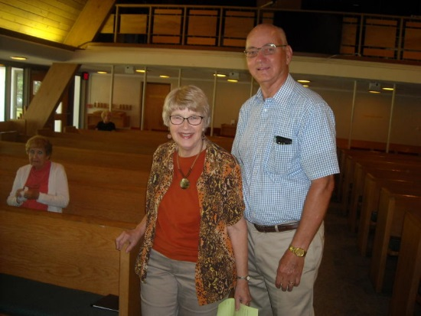
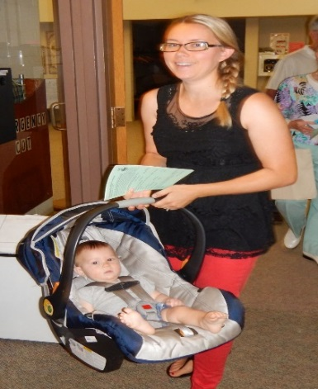
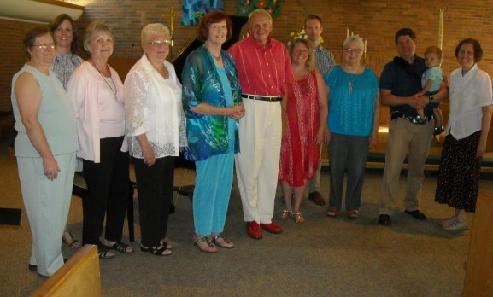
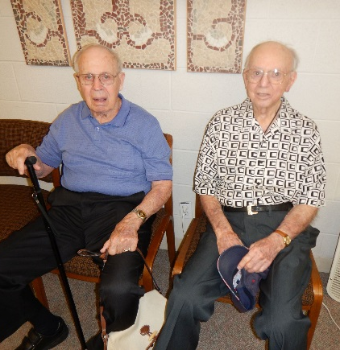
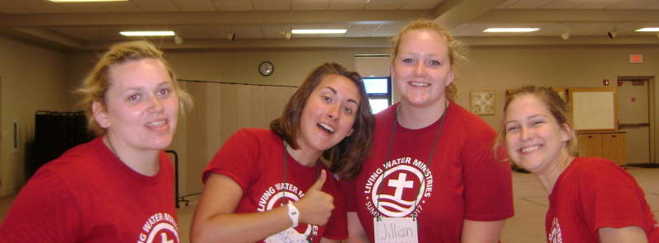
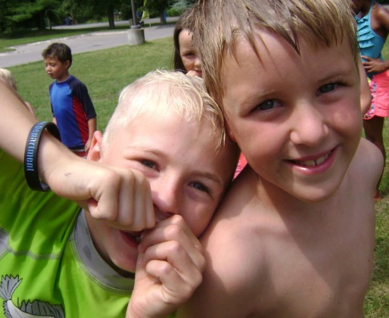
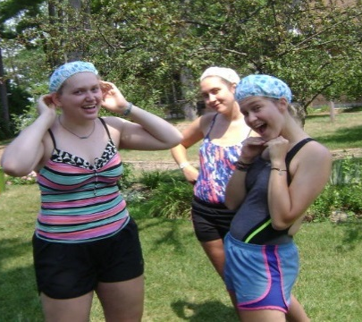
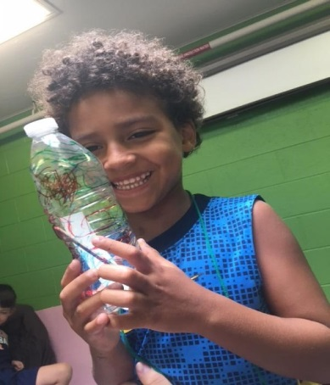
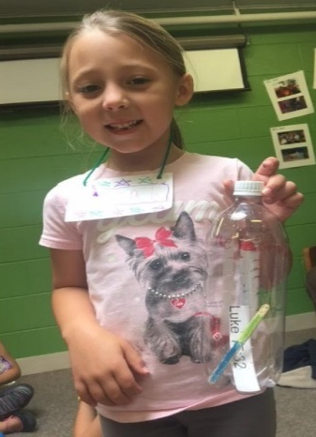
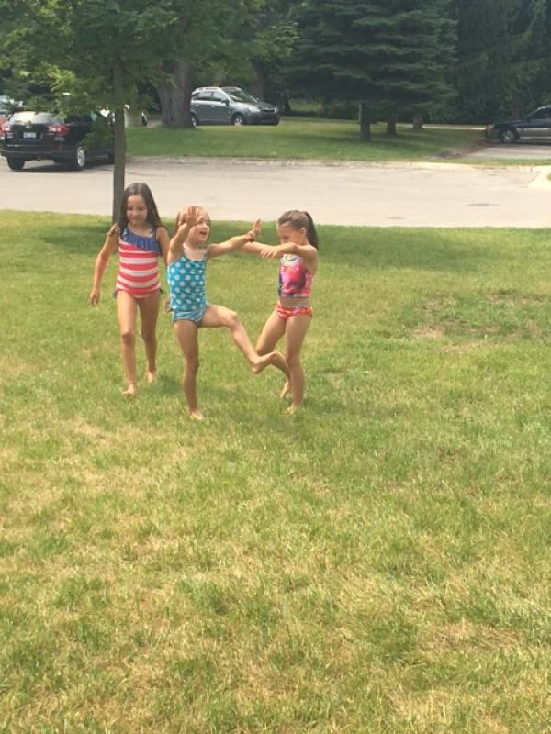
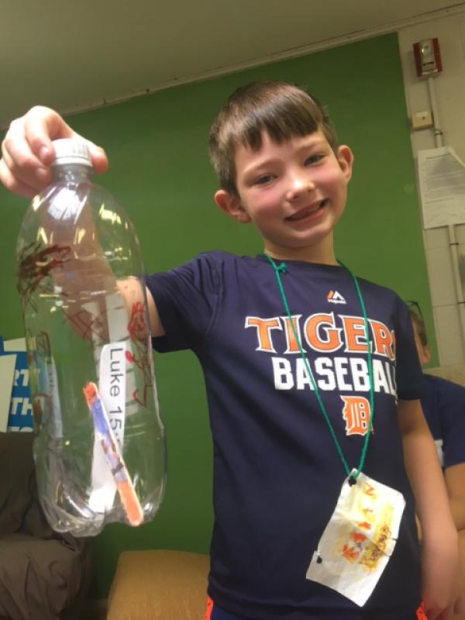
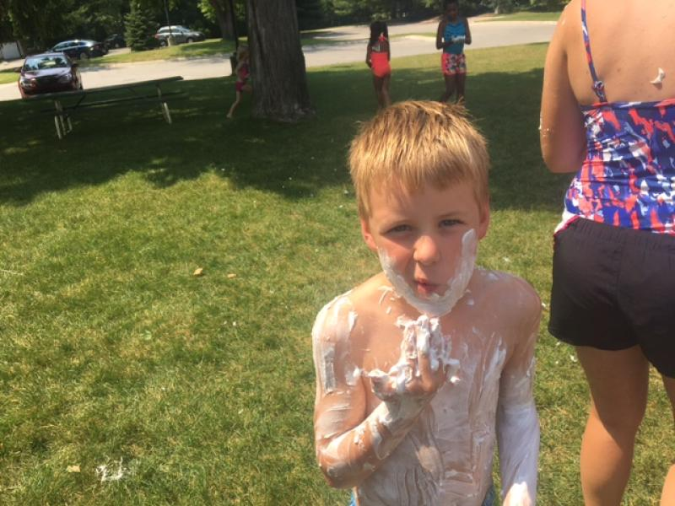
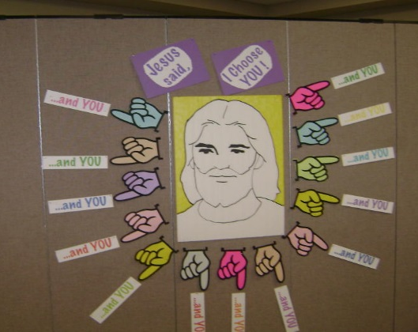
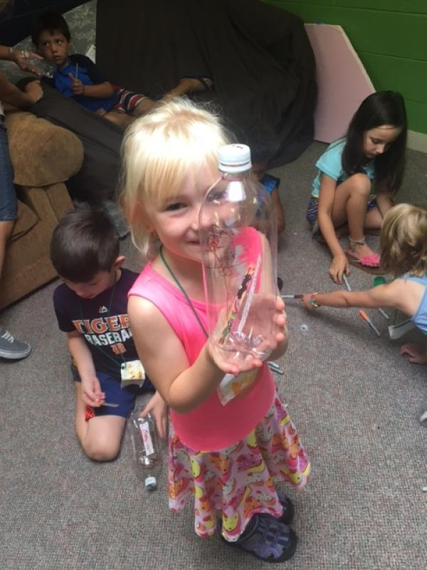
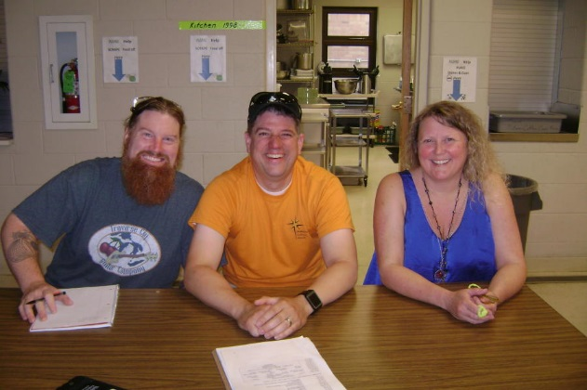
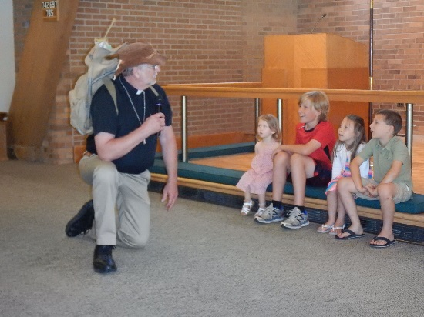
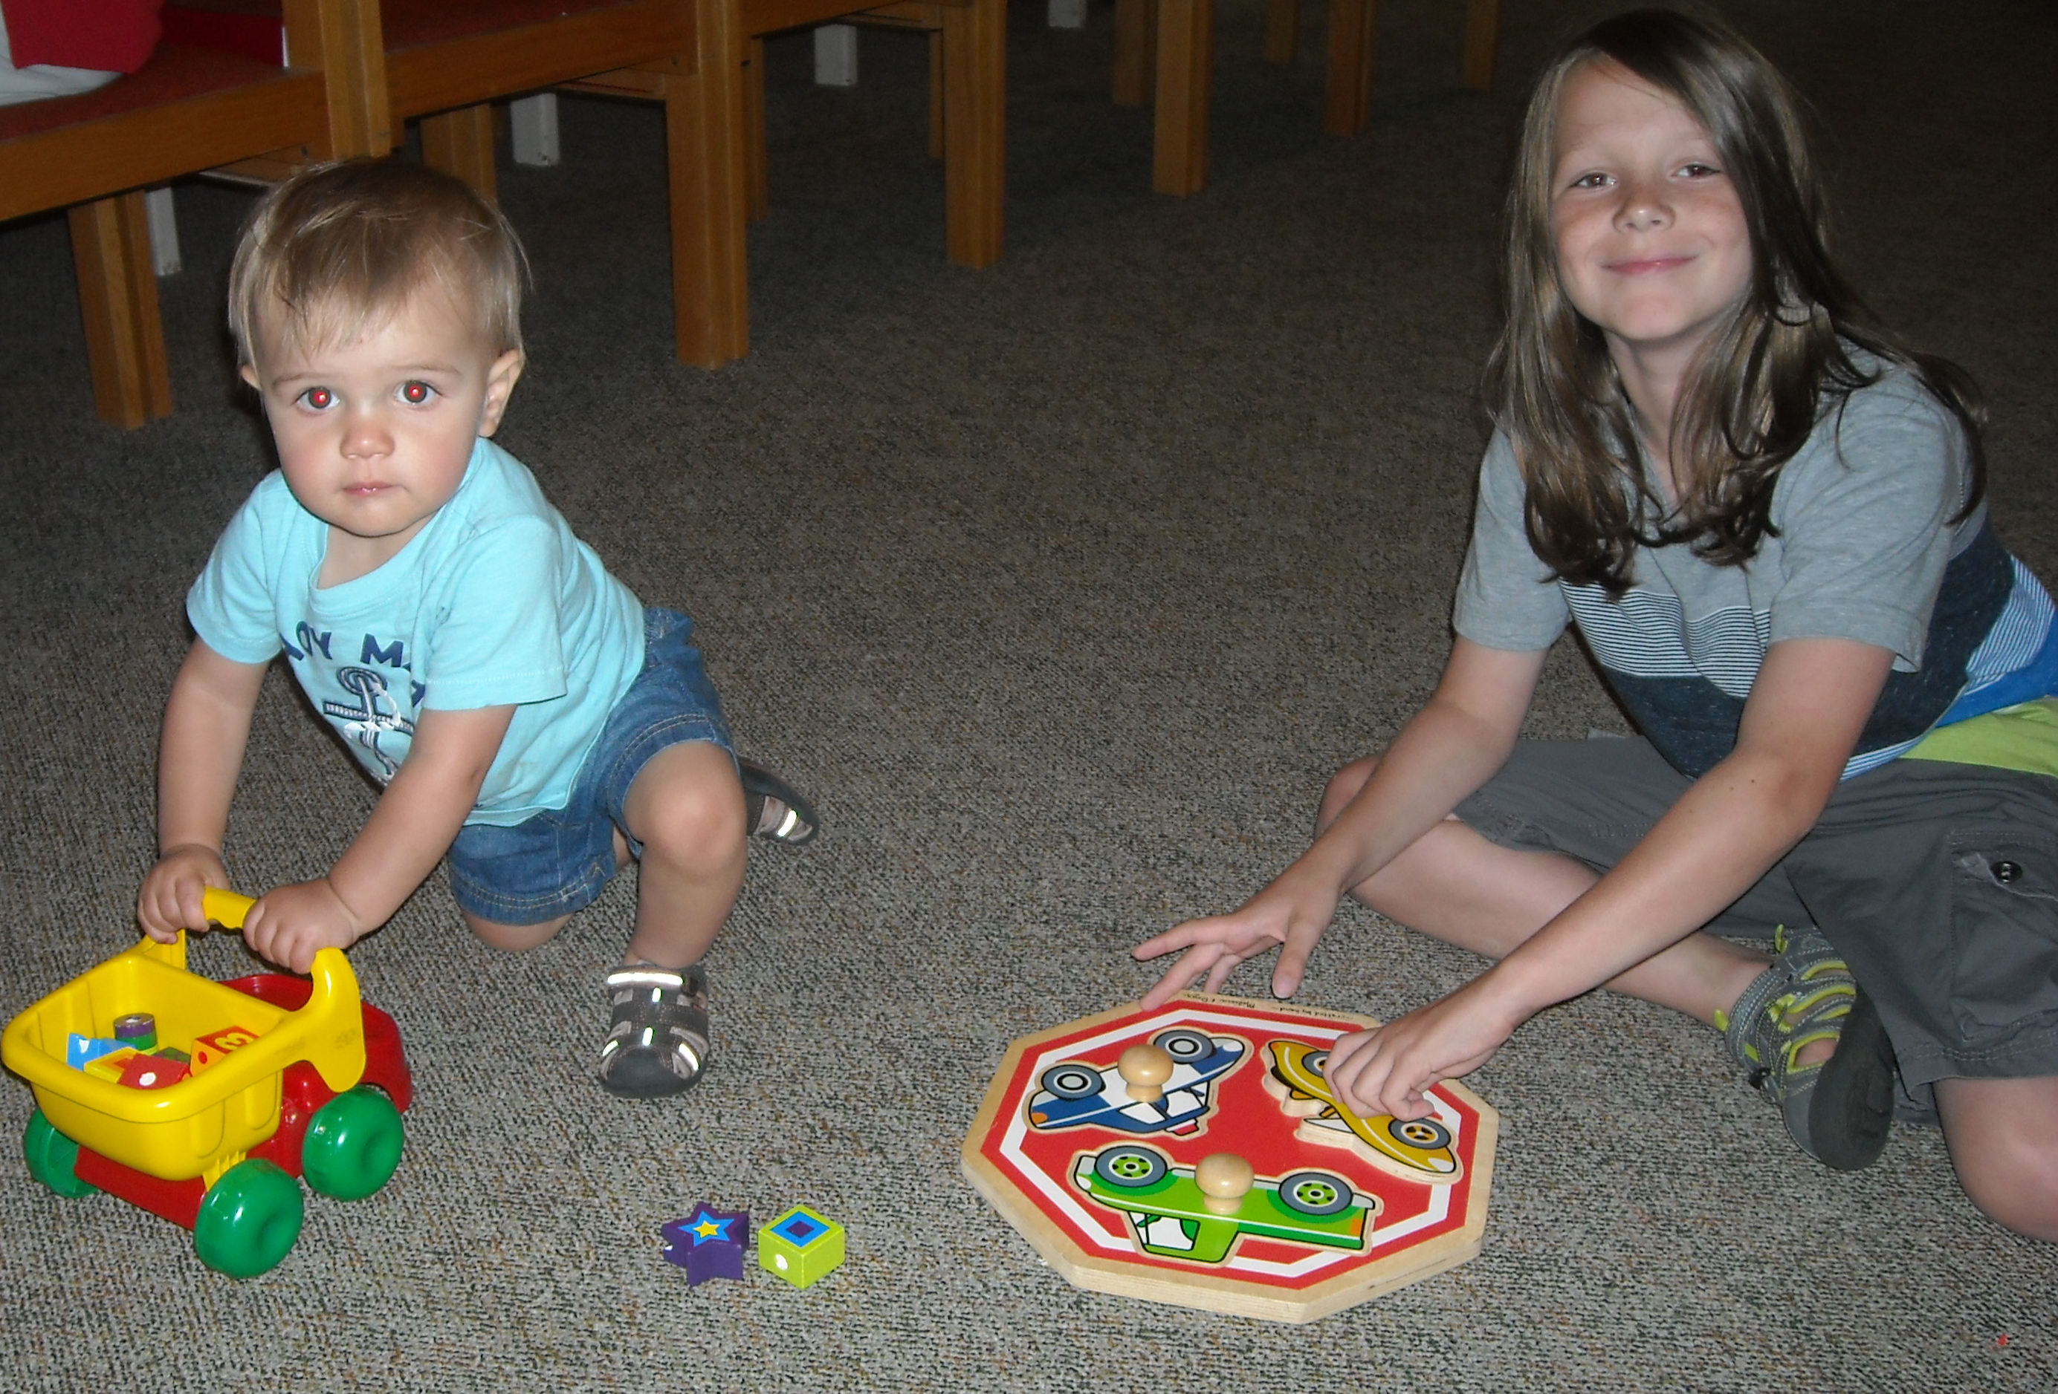
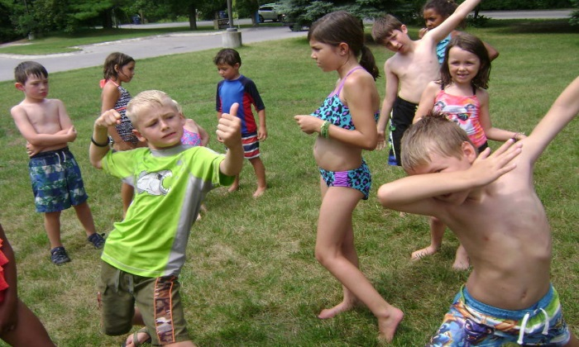
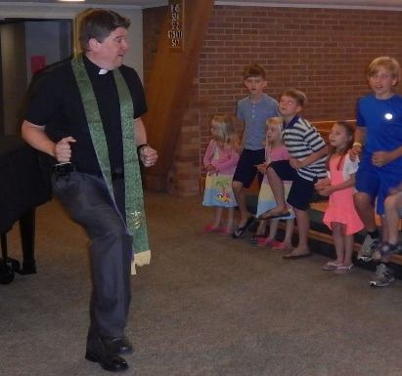

Slide 18
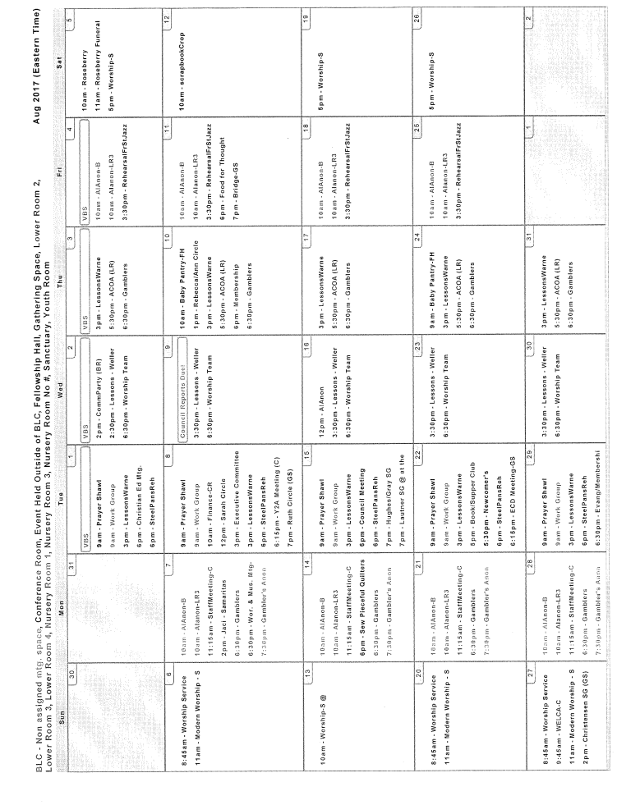
Because of the many activities here at BLC, this is only a partial calendar. You can view the entire calendar at http://www.bethlehemtc.org/community-calendar or call the office at 947-9880 for more information (and corrections/additions).

